Slide 1

Wound and Wound Healing
AHMADABADI A. (MD)
Assistant Professor of Surgery
Mashhad university of medical sciences

Slide 2
Phases of wound healing
1) inflammatory or substrate phase, 2) Proliferative phase, 3) Maturation.
Primary hemostasis in first 1-2 hours. The first cells to enter the wound are platelets: contact with damaged collagen: Release of α-granules that contain multiple growth factors including PDGF, and transforming growth factor β.
Substrate (Inflammatory) phase: Lasts ≈ 3 days. PMNs appear first and remain the predominant cell for ≈48 hours. They are the origin of many inflammatory mediators such as complement and kallikrein. Monocytes reach maximum number 24 hours later and evolve to macrophages that debride the wound. Small number of bacteria can be neutralized by macrophages, but if a large number be present, clinical infection of the wound will result.

Slide 4
Proliferative Phase
Substrates for collagen synthesis are being assembled. Begins on day 3 and continue for ~ 6 weeks. Characterized by additional cellular migration and proliferation, angiogenesis and production of collagen: increase wound strength. The primary cell in this phase is fibroblast. Collagen deposition begins 3-5 days after trauma and peaks around 4-6 weeks. At 1 week after injury, a wound posses only 5% of its final tensile strength; at 1 month 50 and a completely healed wound 80% of the original tensile strength.
Maturation phase: Remodeling and strengthening of collagen by intermolecular cross-linking. The wound scar gradually flatten and less prominent and more pale and supple. In adults: 6-12 months.

Slide 5
Approaches to Wound Management
Acute wounds: Surgical incisions and trauma.
The single greatest deterrent to wound healing is infection and it informs the choice of wound management.
Primary intention: suture, staples, adhesives, tissue transfer technique and flaps. They are generally re-epithelialized within 24-48 hrs, at which time the surgical dressing may be removed. It is easiest to manage by patient, rapid return of function and the final cosmetic result is superior.
The major disadvantage of primary closure is the risk of wound infection that can occur in the closed space created.

Slide 6
Secondary intention
Leave it open to heal, “wet-to-dry” dressing or negative pressure wound therapy.
Negative pressure therapy stimulates more rapid closure of the wound and simultaneously promoting drainage and creating a moist environment favorable for the ingrowth of granulation tissue.
Granulation tissue, characterized by friable reddish moist granules of tiny capillary buds, will form in the base of the open wound. Epithelial cell cannot migrate across granulation tissue, so healing occurs primarily by wound contraction. Myofibroblasts at the edges of the wound gradually draw the edges of the wound together. Wound contraction is better in areas with redundant tissue such as abdomen and buttock, and is not in scalp or peritibial where the skin is taut.
Disadvantages: greater cost, uncomfortable daily dressing change.
Advantage: wound infection is virtually impossible and is utilized in highly contaminated wounds such as sub-cutaneous abscess, or where the likelihood of SSI is deemed too great.

Slide 7
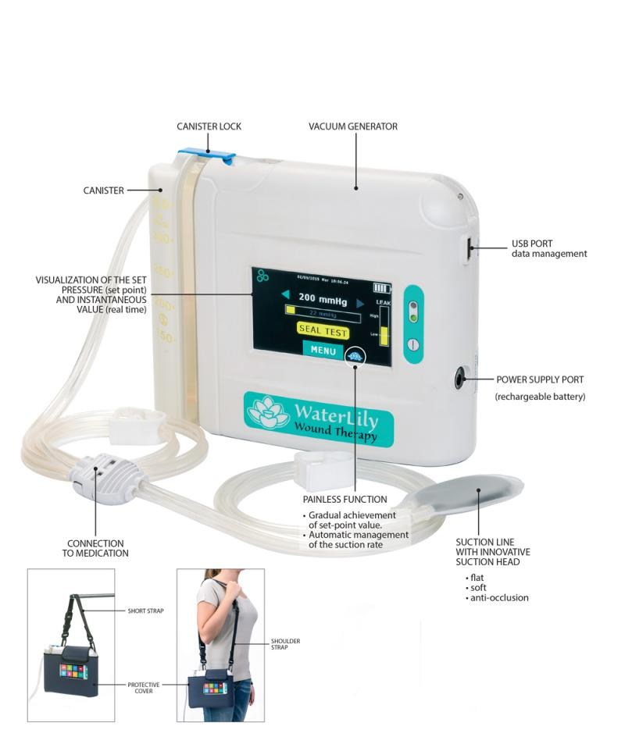
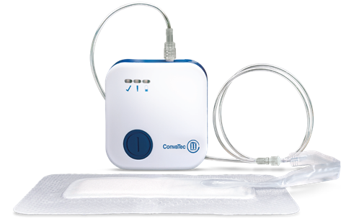

Slide 8
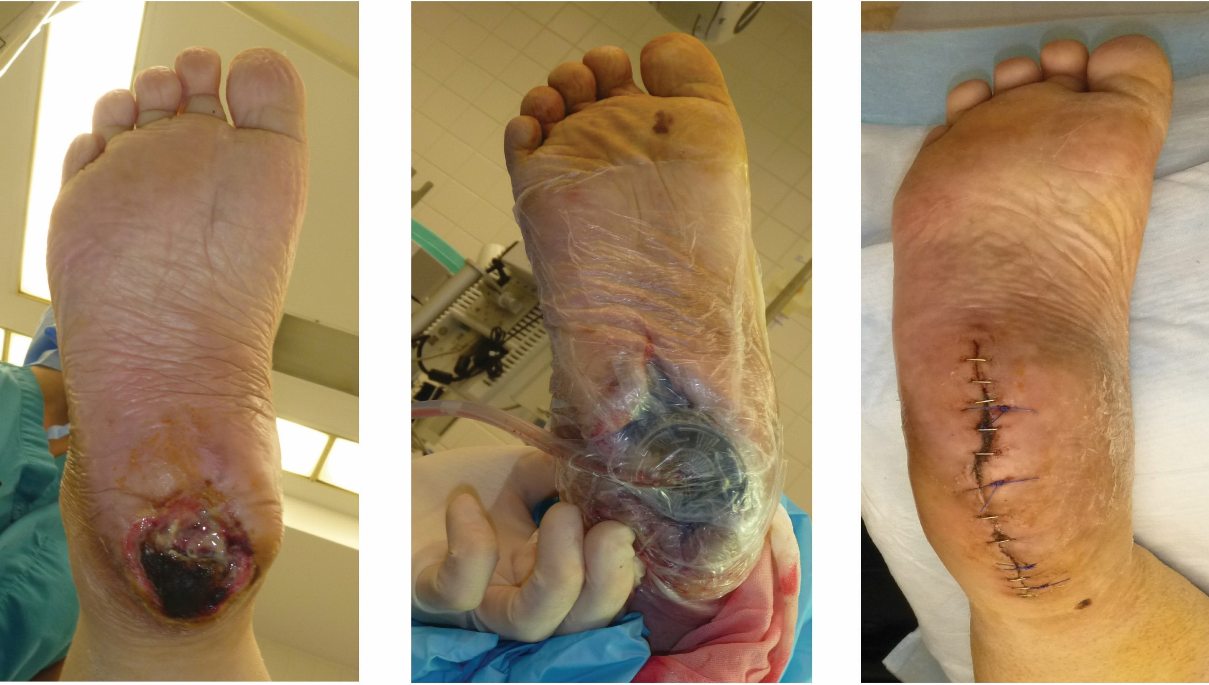

Slide 9
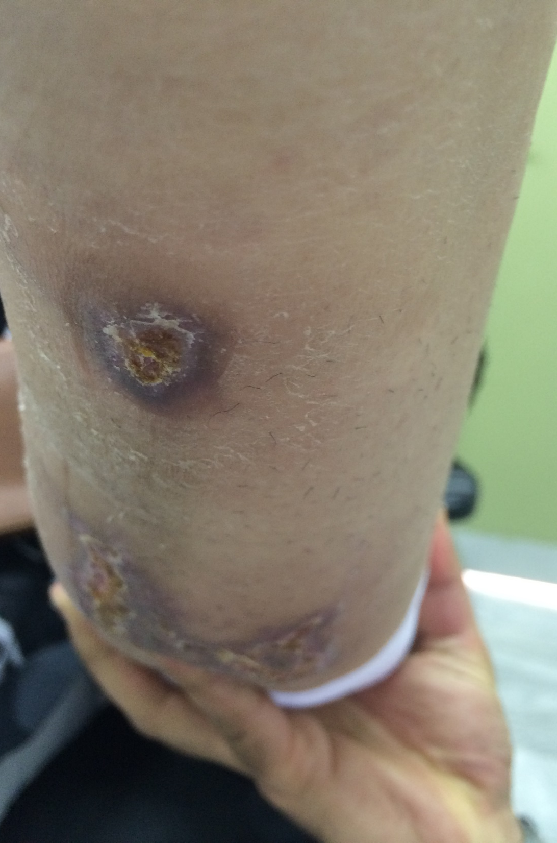
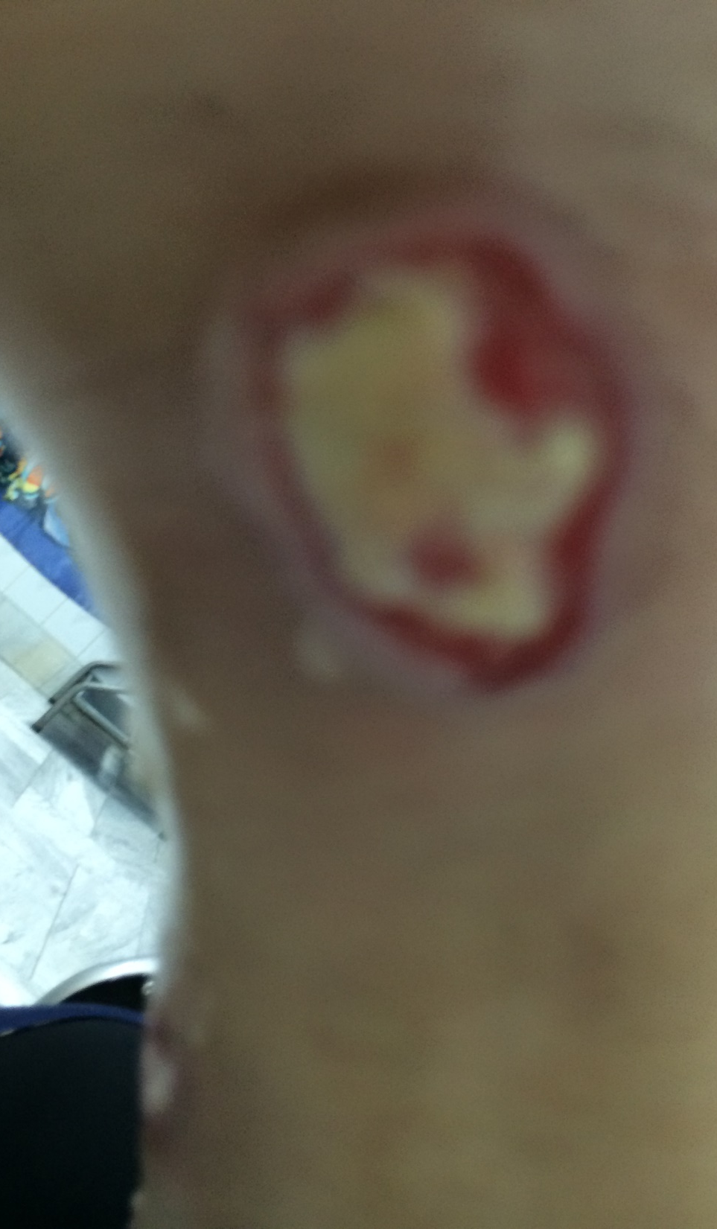
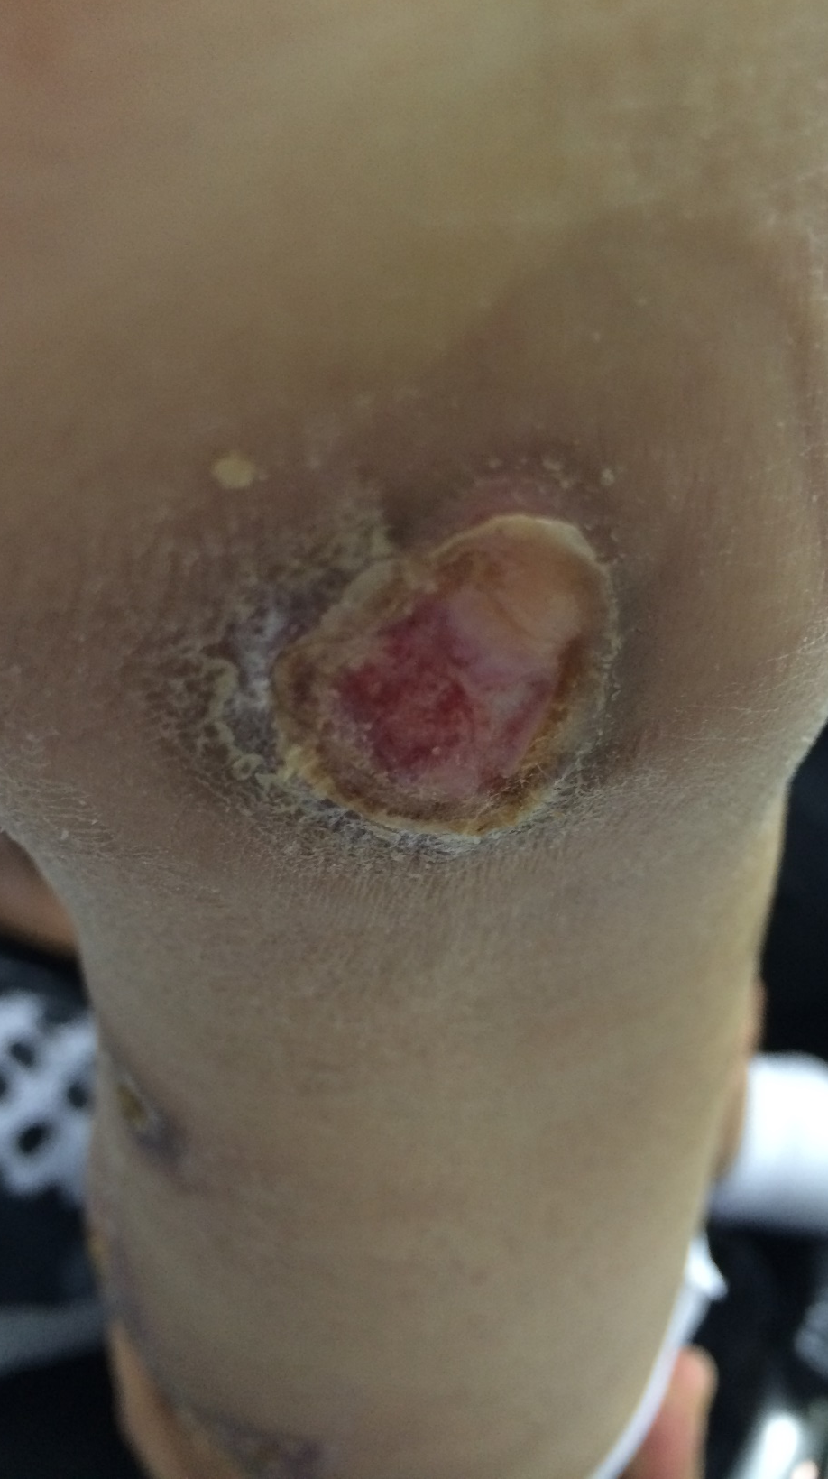

Slide 10
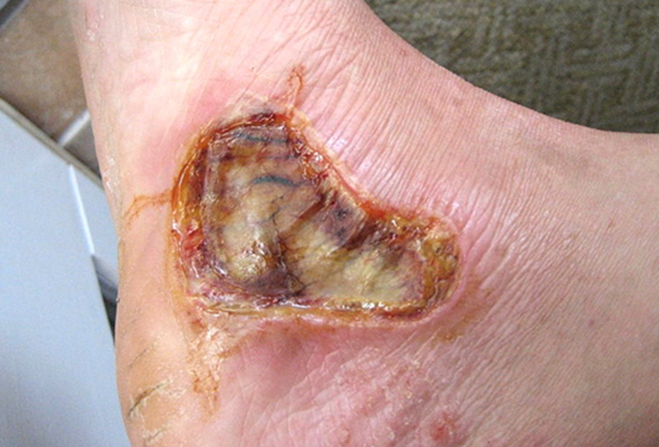

Slide 11
Delayed Primary Closure (DPC) or Healing by Tertiary Intention
The wound is initially managed as a secondary intention and after approximately 5 days, when the wound is clean and granulation tissue is abundant, the wound edges are actively approximated. Granulation tissue is not sterile but is extremely vascular and highly resistant to infection.
DPC combines the advantages of primary wound closure in terms of final cosmetic result and rapid return to function, while significantly reducing the risk of wound infection.

Slide 12
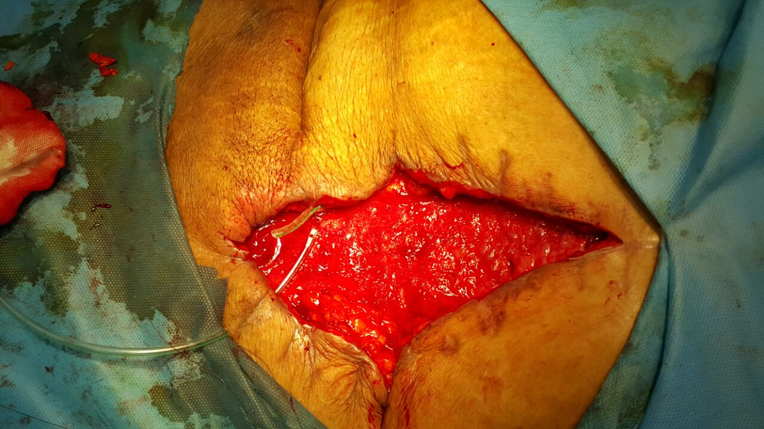
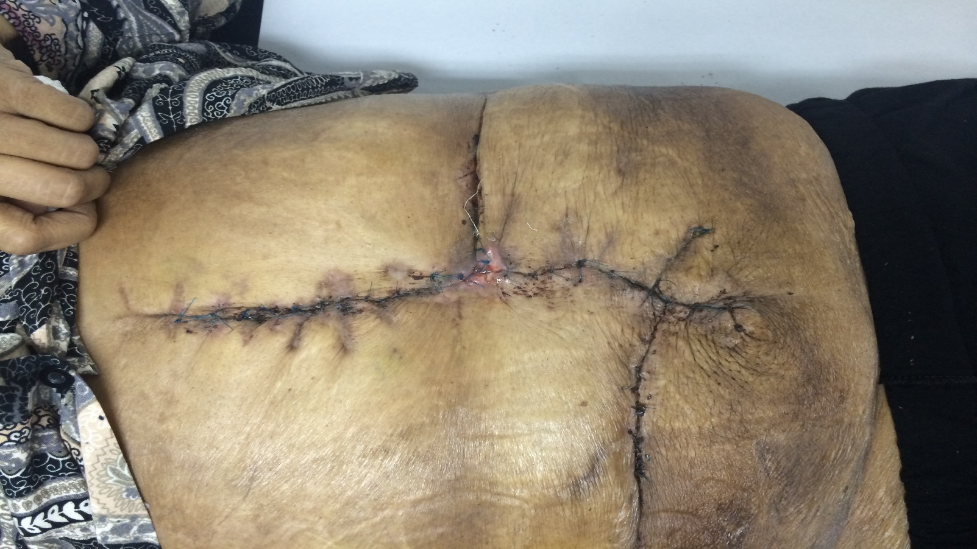

Slide 13
Skin Grafting
For large surface area full-thickness wounds that cannot be closed by secondary intention.
Partial thickness skin graft: epidermis + a portion of the underlying dermis.
Imbibition: For the first 48 Hrs, the grafted skin derives its nutrients by passive absorption from the recipient bed. Thereafter the graft becomes revascularized and adherent to the bed.

Slide 14
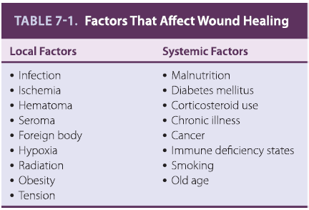

Slide 15
Systemic Factors
Adequate protein and calories to support wound healing.
Folic acid is critical to the proper formation of collagen.
Vitamin C deficiency: Scurvy: impaired wound healing, cutaneous sores and hemorrhagic gingivitis.
Vitamin E: Aids in immune function, fibroblast stimulation and inhibits prostaglandin synthesis.
Selenium is important for lymphocyte function and protects membranes from free radical damage.
Zinc: Possibly the most essential element for wound healing: deficiency leads to  fibroblast proliferation,  collagen synthesis, and likely  lymphocyte cellular immunity. Zinc is a cofactor for RNA and DNA polymerase.
Adequate fat intake is required for the absorption of Vit D, A, K and E.
Vitamin K is essential for the synthesis of clotting factors II, VII, IX, and X.

Slide 16
Vit. A:  inflammatory response,  collagen synthesis and  the influx of macrophages in to a wound.
Magnesium is required for protein synthesis
Poorly controlled DM: Hyperglycemia: Impaired wound healing and alters collagen formation. Inhibits neutrophil, fibroblast. And endothelial cell proliferation within the wound.
Drugs: Corticosteroids: Blunt the inflammatory response,  the available Vit A in the wound, and alter the deposition and remodeling of collagen. Cancer chemotherapy negatively affect wound healing.
Chronic illness (immune deficiency, cancer, uremia, liver disease and jaundice) predispose patient to infection, protein deficiency, and malnutrition.
Smoking:  oxygen carrying capacity, may  collagen formation within a wound

Slide 17
Management of chronic wounds
Reparative processes of normal wound healing fail to occur in an orderly and timely sequence. Most often, chronic wound are stalled in the inflammatory phase of healing and have poor granulation tissue formation, altered cell cycle, and biochemical imbalance.
Systemic factors: Malnutrition, uremia, and hyperglycemia.
Local factors: Edema, infection, arterial insufficiency, fecal soiling, and pressure on the wound
Advanced care for chronic wound: 1) Intermittent negative-pressure wound therapy, 2) Topical foams and occlusive dressings to promote a moist wound environment, 3) Topical growth factors and collagen preparations, 4) Topical broad-spectrum antimicrobial compounds, 5) Topical enzymatic debridement preparations, 6) biologic dressings, 7) Hyperbaric oxygen therapy.

Slide 18
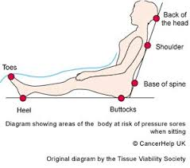
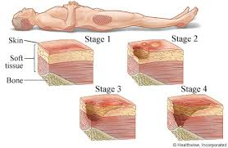
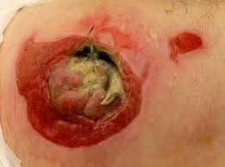
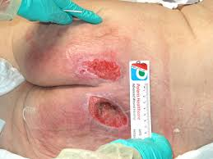
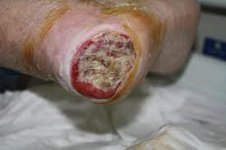

Slide 19


Thanks for your attention

