Slide 1
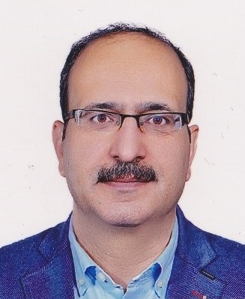
10. Burns
Lawrence’s Essentials of General Surgery and Surgical Specialties
6th edition
Ali Ahmadabadi (MD)
Associate professor of surgery
Fellowship of burns and reconstructive surgery
Mashhad University of Medical Sciences
https://dr.ahmadabadi.ir

Slide 2
Epidermal (1st degree burns)
Dermal capillary dilate, within minutes, resolves within a few hours
Red, Moderately painful
Blanching
Blistering absent
Only supportive care even in extensive 1st degree burns: Oral analgesics +adequate oral fluids + soothing topical oints such as Neomycin sulfate؟؟
https://dr.ahmadabadi.ir

Slide 3
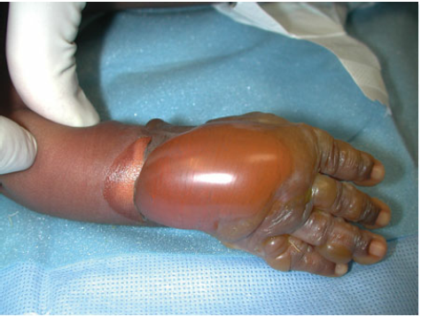
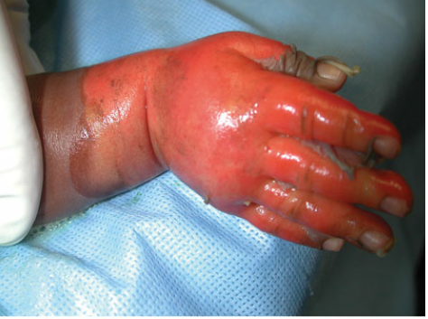
Extends into but not through the dermis. A. Superficial partial thickness burns: 1.Reddened skin, 2.Distended epidermal blisters filled with proteinaceous fluid 3.The underlying dermis is moist, 4.blanches on direct pressure, very painful
Partial thickness burns (Second degree burns)
https://dr.ahmadabadi.ir

Slide 4
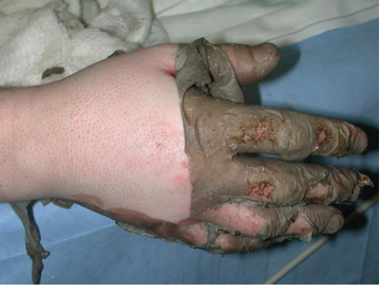
Coagulation necrosis of the upper dermis: dry, thickened texture. Erythema often absent Various colors, mostly waxy white Less painful
B.Deep partial thickness burns
Even very deep ones can heal over the time, but damaged dermis does not regenerate, instead replaces by scar tissue, which is often rigid, tender and friable.
So E&G is preferred.

Slide 5
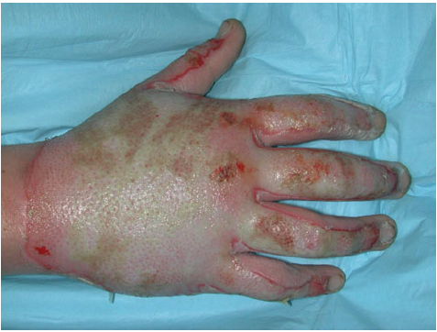
Eschar
Coating of dead tissue, coagulated serum and debris within 24-48 hrs.
Eschar vs Scar
Superficial 2nd degree: within 10-14 days: Eschar separation: skin Buds
Proximal wrist: pink healing tissue with regularly spaced, small darker-red spots (“skin buds”)
Uniform skin buds is necessary for healing
https://dr.ahmadabadi.ir

Slide 6
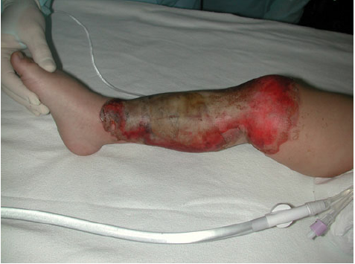
Indeterminate Depth: Some features of partial and full-thickness burns: 10 14 days conservative management.
Third degree burns = Full-thickness: All layers of skin: Covered with dry, avascular, coagulum, usually insensate, non-blanching, risk of compartment syndrome.
Almost any color: chemical burns: waxy white, flame: black charred surface. Scalding: dark cherry red
4th degree: extending to the bone???

Slide 7
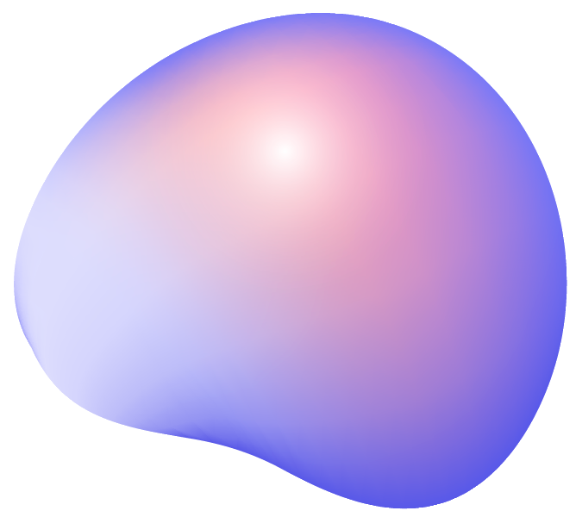
Inhalation injury
Critical key point: Fire in an enclosed space.
Toxic smoke like CO: Strongly suspected in any patient with altered mental status following exposure to smoke.
Pulse oximetry, ABG, 100% O₂ , prehospital, intubation?
Hyperbaric oxygen?: COHb half life from 80 min to 20 min in 3 bar.
Thermal upper airway injury: progressive edema in first 24 Hrs
Lower airway injury: true inhalation injury. Large amount of CO, formaldehyde, formic acid, cyanide, & hydrochloric acid produced by incomplete combustion of cotton, wood & paper: severe damage to the mucosal cells.
Cyanide as by product of plastics: persistent metabolic acidosis not
responsive to fluid resuscitation. Hydroxycobalamin: dark purple
color urine. Symptoms may be absent in first 24-48 Hrs.
Fiber-optic bronchoscopy O₂ therapy not mentioned in the text😐
https://dr.ahmadabadi.ir

Slide 8
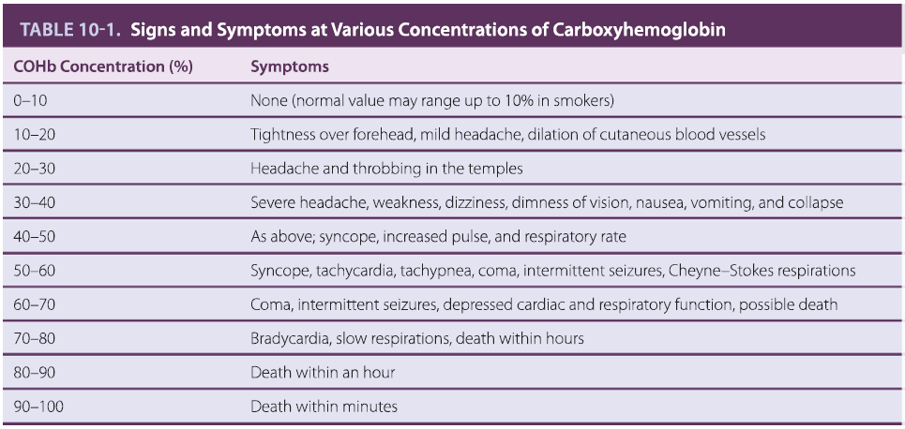
https://dr.ahmadabadi.ir

Slide 9
Initial Care
Be ware about HYPOTHERMIA
Consider burn patients as trauma ones: ATLS.
Stop burning process before any other measures:
Flame: Dousing, smothering or rolling patient on the ground.
Scalding: Cool water or moist compress.
Caustic chemical: diluting with copious amount of water.
Electrocution: shot off source of current.
Primary Survey: ABC, Consider delay edema in severe burns of head and neck. Be ware about compartment syndrome in extremities and abdomen.
Resuscitation: in major burns: 2 large bore IV access, Foley catheter, fluid therapy without formula calculation.
https://dr.ahmadabadi.ir

Slide 10
Scondary survey
Complete examination from tip to toe.
Culculate extend of burn injury (%TBSA) by: Rule of NINES, Lund and Browder chart. Palm of hand with fingers= 1%.
First degree burns are not considered.
https://dr.ahmadabadi.ir

Slide 11
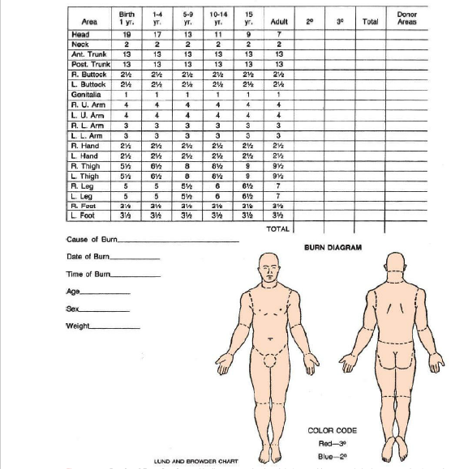

Slide 12
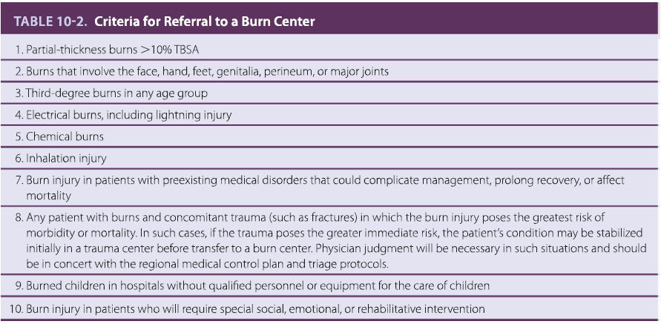
https://dr.ahmadabadi.ir

Slide 13
Definitive care of burn injury
Resuscitation period
Wound closure
Rehabilitation
https://dr.ahmadabadi.ir

Slide 14
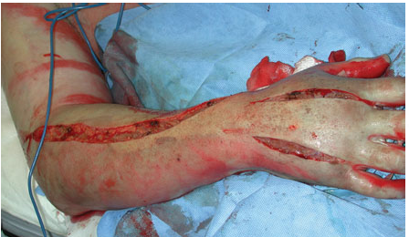
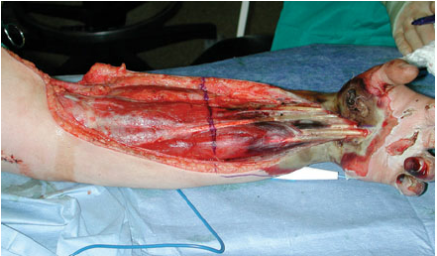
Resuscitation period
First 24-48 Hrs post injury
Risk of burn shock in burns ≥ 15-20%
Formal fluid resuscitation in Burns ≥ 10-15%
V= 2-4 * W * %TBSA lactated Ringer’s ⅟₂ In first 8 hours, ⅟₂ in next 16 hours.
Frequently and repeated evaluation
Urine output > 30 ml/hour in adults and 1- 1.5 ml/kg/hour in children
Frequent evaluation of extremities for compartment syndrome: 5 or 6 P, painful passive motion
Chest and abdominal compartment
Fasciotomy
Abdominal compartment syndrome

Slide 15
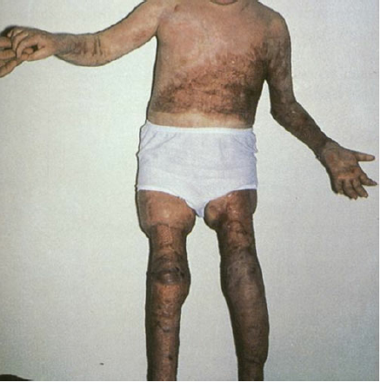
Wound closure period
Early excision and skin grafting
Tangential excision: require skill, more blood loss, Better cosmetic and functional results.
Fascial excision: easy to perform. Less blood loss, good skin graft take, but disfiguring, joint stiffness and poor mobility.
Limited indeterminate or mixed burns: conservative treatment for 10-14 days
Permanent coverage: skin autograft: full-thickness vs partial thickness.
Meshed vs sheet skin graft
Skin allograft
Xenograft including pig skin
Human amniotic membrane
Synthetic dressing: the idea of Artificial Skin
Cultured Epithelial Autograft, C…E…Allograft? “In text”

Slide 16
Infection control
The skin surface is sterile after burning for 24-48 hours.
Colonization: harmless
Invasive infection = Burn wound sepsis: is often fatal
Topical antibiotics: Silver nitrate, Silver sulfadiazine, Mafenide acetate
The most effective technique in the battle against burn wound infection is EE&G
Wound care: regular and meticulous washing and debridement of old creams, dry serum and released eschar. At least twice daily in traditional dressing by creams.
New silver containing dressings
Pneumonia
Other infections

Slide 17
Are the antimicrobial agents the only way for
Source control?
Systemic antimicrobial agents are not able to penetrate highly infected necrotic tissues
https://dr.ahmadabadi.ir

Slide 18
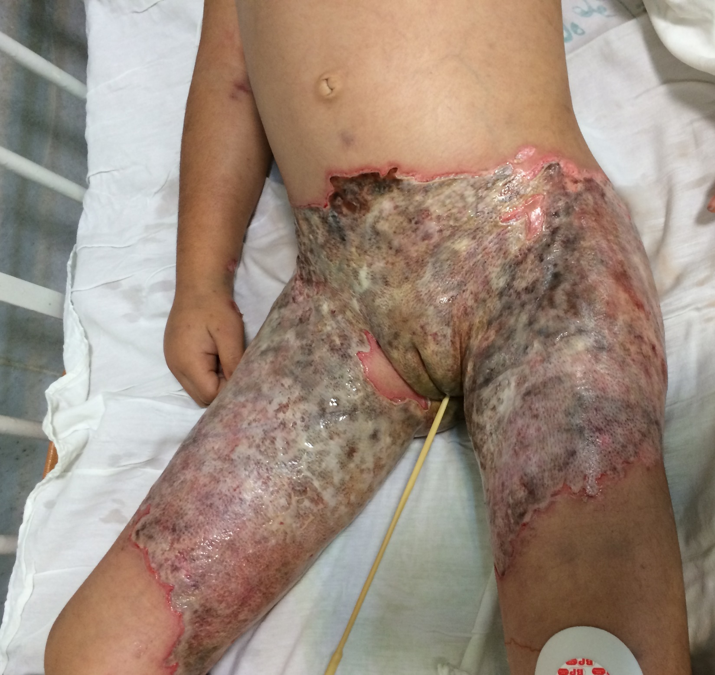
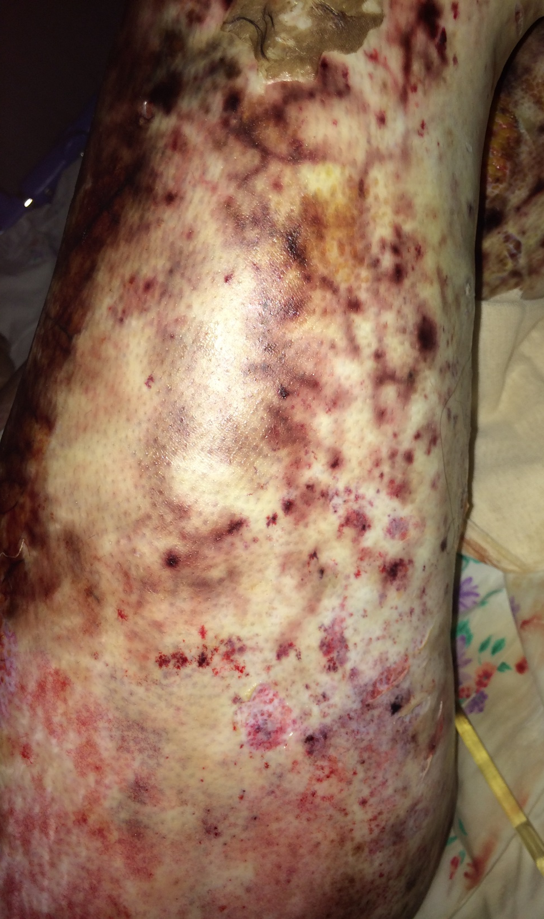
https://dr.ahmadabadi.ir

Slide 19
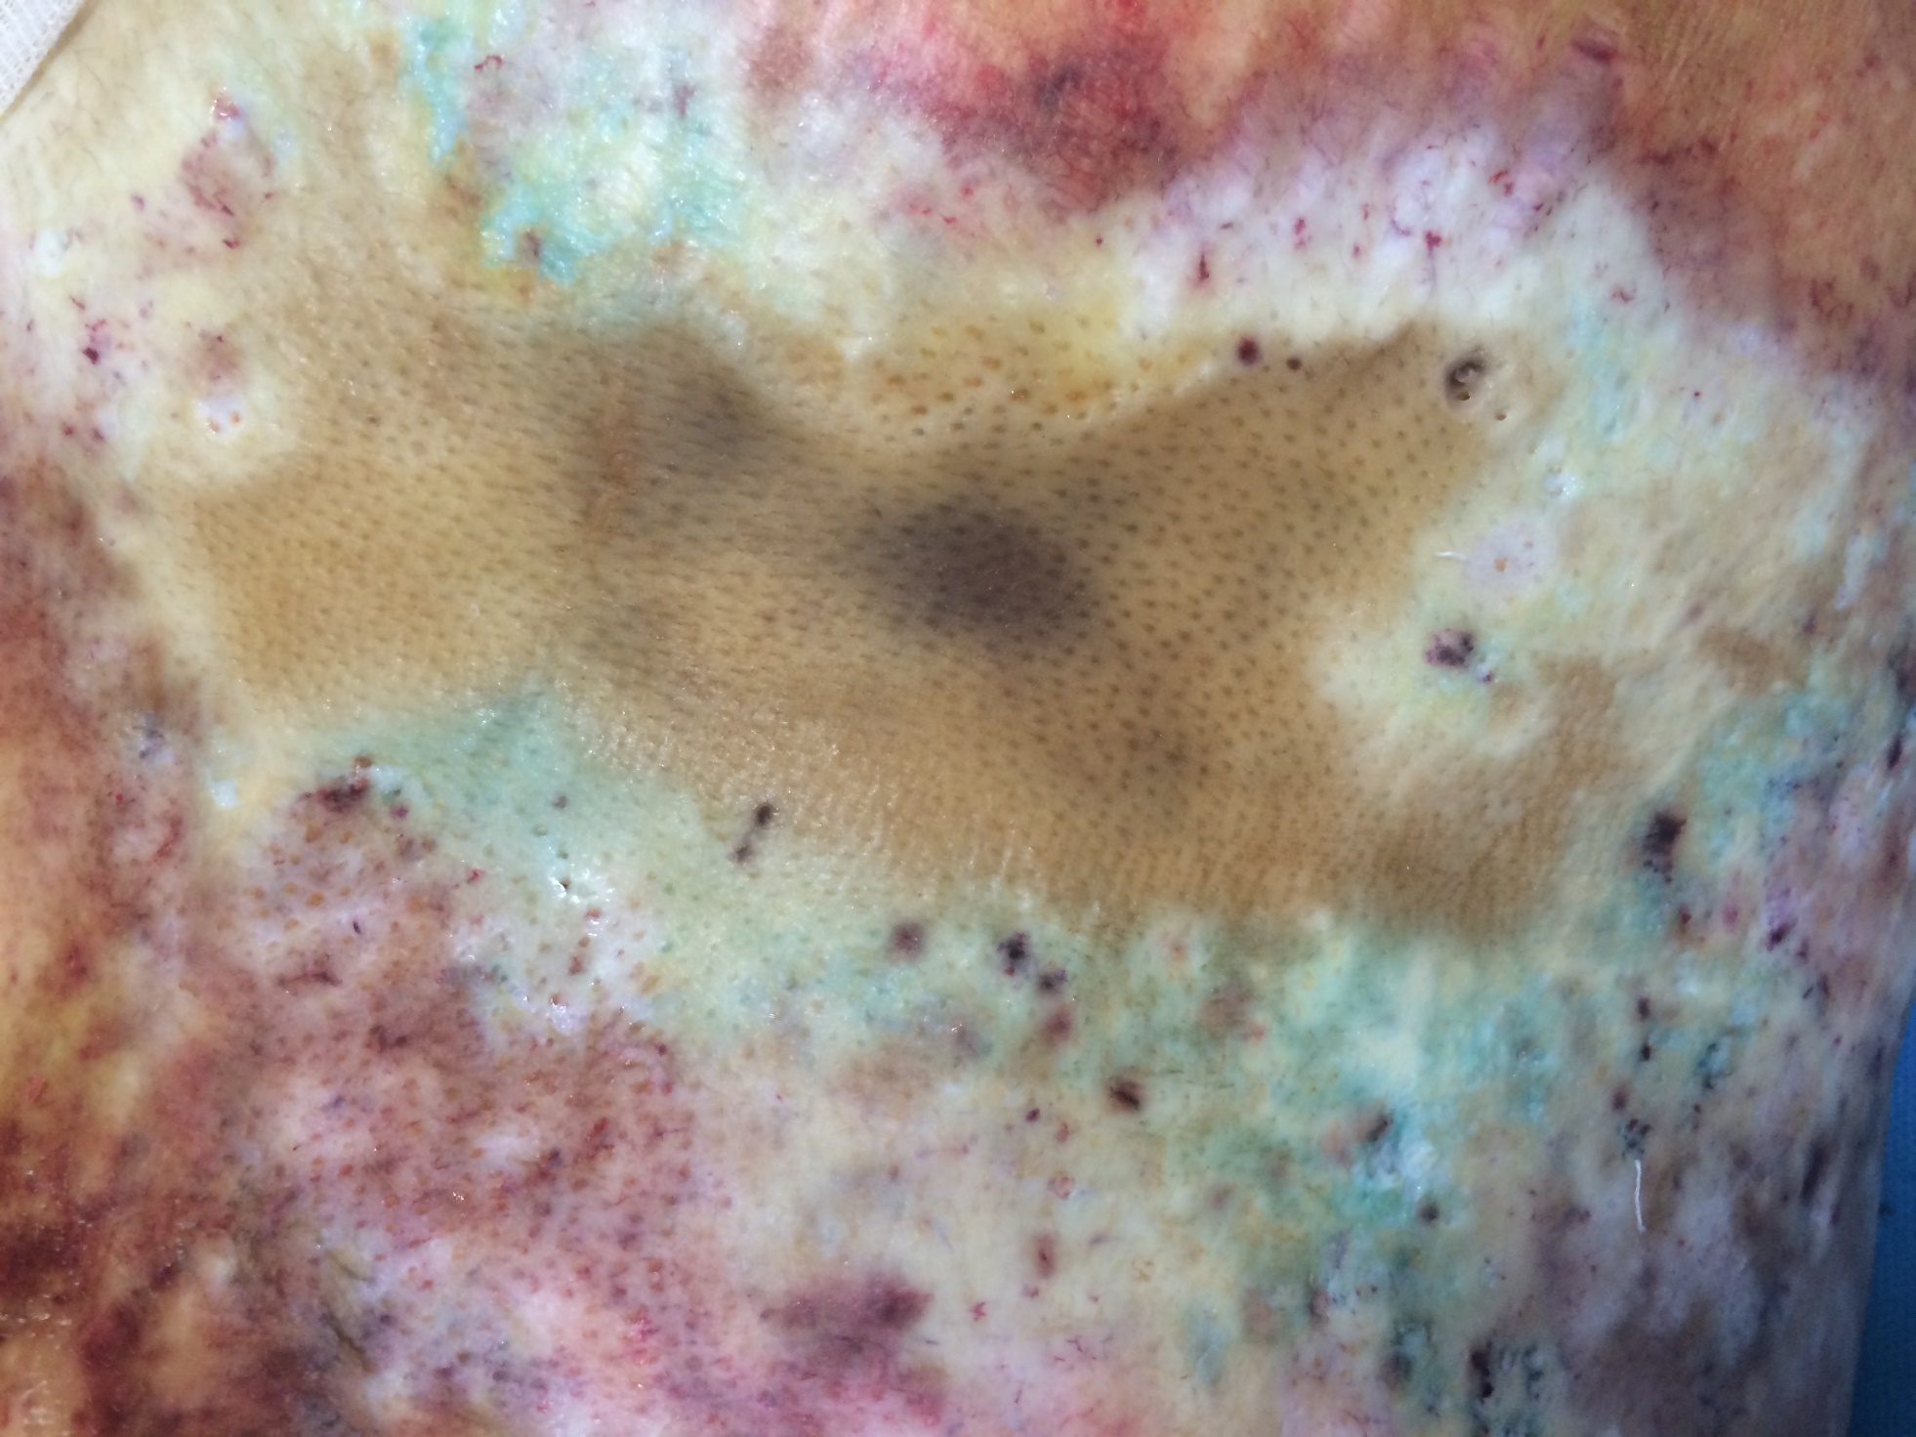
https://dr.ahmadabadi.ir

Slide 20
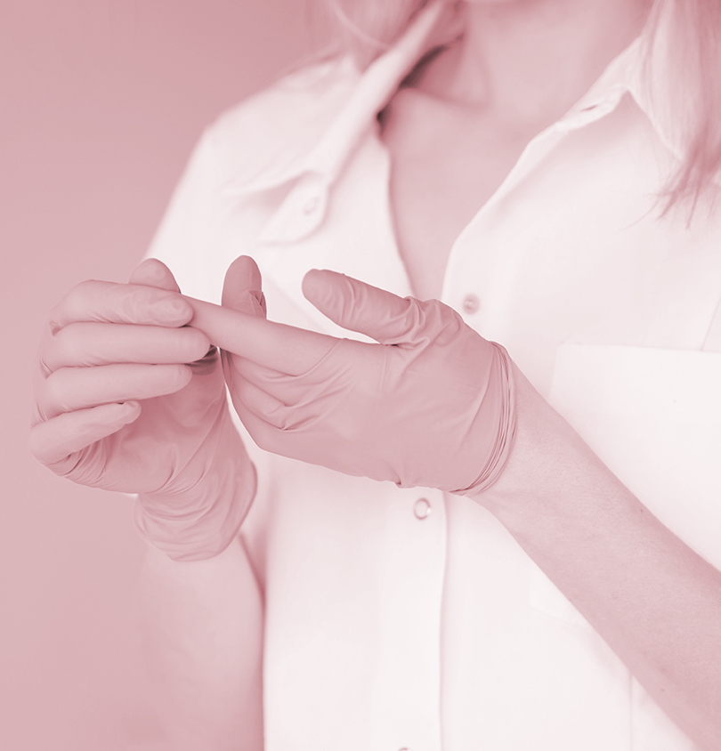
Nutritional support
Metabolic rate can exceed twice for prolonged periods: wasting respiratory muscles and immunocompromised.
Enteral feeding is preferred.
Indirect calorimetry and nitrogen balance determination at least weekly.
High protein diet: 1.5 2 gr protein/ Kg
https://dr.ahmadabadi.ir

Slide 21
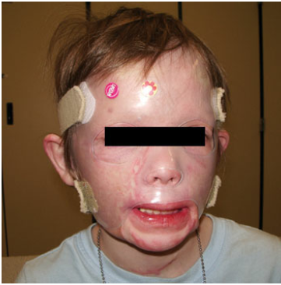
The Rehabilitation Phase.
Rehabilitation begins at the time of injury.
Scar tissue is pliable soon after injury.
The scar tissue is inflamed and remodels and reshapes at least for one year post injury.
Stretching exercise, movement, and pressure garment
https://dr.ahmadabadi.ir

Slide 22
Chemical burns
Alkalis: Dissolve and combine with proteins of tissues: alkaline proteinates: hydroxide ions: further chemical reactions: more injury.
Acids: protein breakdown by hydrolysis: Eschar: less penetration.
Organic compound such as petroleum products and phenols: dissolve cell membranes.
First: Providers safety, then patient’s clothes removal, brushing dry powders like lime, irrigation by copious volume of water, pHmetry,
Consider systemic intoxication: ABG, Electrolytes, LFT
Urgent surgery to remove the wound may be needed.
It is difficult to determine the depth of burns
Fluid resuscitation based on TBSA
https://dr.ahmadabadi.ir

Slide 23
Electrical injury
Low voltage vs High voltage: a local event vs an iceberg
In Emergency Department:
1- R/O Trauma: ABC, ATLS, Primary and secondary survey. Consider rupture of eardrums in lightning.
2- Cardiac disturbances: ECG, Admission? Monitoring?
3- Rhabdomyolysis and ATN: Resuscitation, U/O≥ 100cc/Hr, Bicarbonate? Mannitol?
4- Compartment Syndrome
5- wounds: contact point, current injury, flash burn (electrical arc), flame due to ignition of clothes
Follow up: ocular (cataract), Peripheral neuropathy
https://dr.ahmadabadi.ir

Slide 24
Outpatient and minor burns
Relieve pain, prevent infection, encourage healing
Cooling: Tap water (12-25ᵒc), No ice or ice water. Hypothermia
Washing the wound, Blisters?
Topical antibiotics: creams, ointments, new dressings
Systemic antibiotics:
Deep burns: healing during 3 weeks, EE&G
https://dr.ahmadabadi.ir

Slide 25
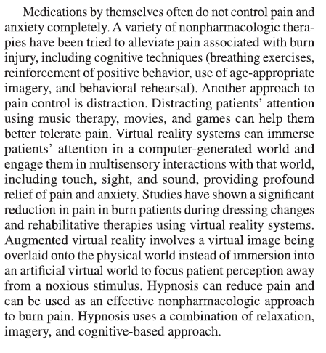
Itching and pain
Acute phase pain: IV analgesics are preferred on a scheduled basis. Opioids: Morphine, fentanyl, and drugs like ketamine and nitrous oxide.
Outpatient: Hydrocodone, Oxycodone + Acetaminophen, NSAIDs
Anxiolytics: Lorazepam, Diazepam, Midazolam,often in combination with opioids.
α₂ adrenergic agonists like as: clonidine and dexmedetomidine: excellent sedative, analgesic and anxiolytic.

Slide 26
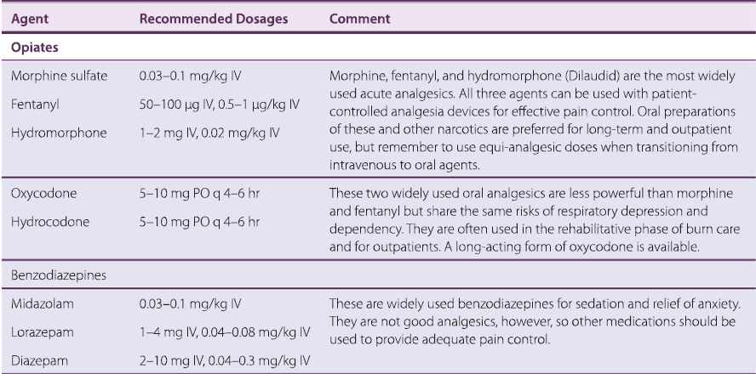

Slide 27
Itching: In > 50% of patients. It can last for 12 years. Treatment is effective only in 36%
Topical drugs (Tricyclic histamine receptor blockers, doxepin), gabapentin, dapsone, ondansetron and H1/H2 blocker combination therapy are effective. Also: simple cooling, transcutaneous electrical nerve stimulation and massage.

Slide 28
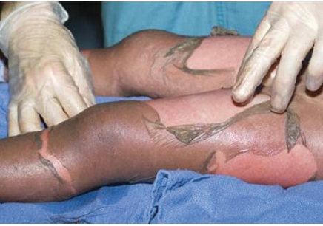
Treatment of other disorders in burn unit
SJS & TEN, SJS/TEN Overlap: Drugs 80% of cases, Dilantin and sulfonamides 40% , Others: NSAIDS, Other antibiotics, Upper airway infections and viral illness,
Viral like prodromal, macular rash, confluent of rashes, involvement of mucosal surfaces, epidermal detachment, Nikolski sign.
Treatment: Discontinuation of inciting drug, skin biopsy at the edge of the blistered area and uninvolved skin, skin care (secondary skin infection a major cause of death), sulfa-containing dressing should be avoided.
Systemic steroids? Immunoglobulin? (inhibition of CD95),

Slide 29
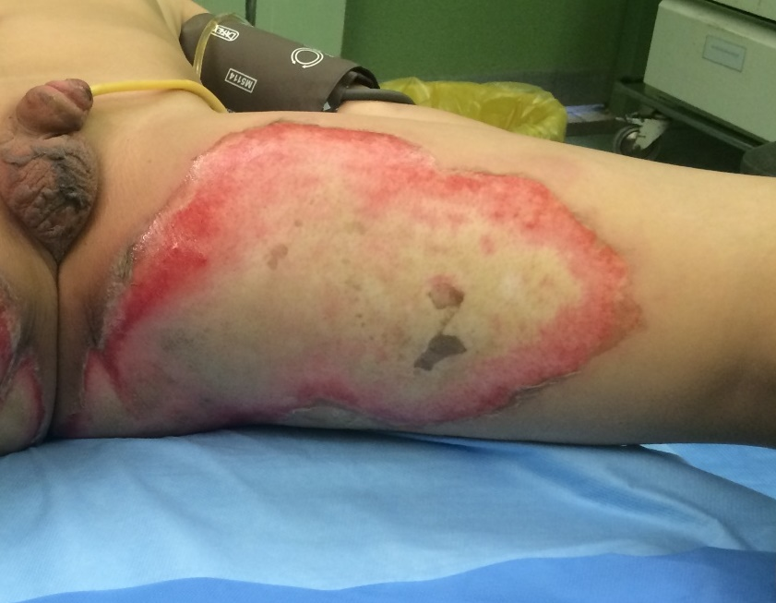
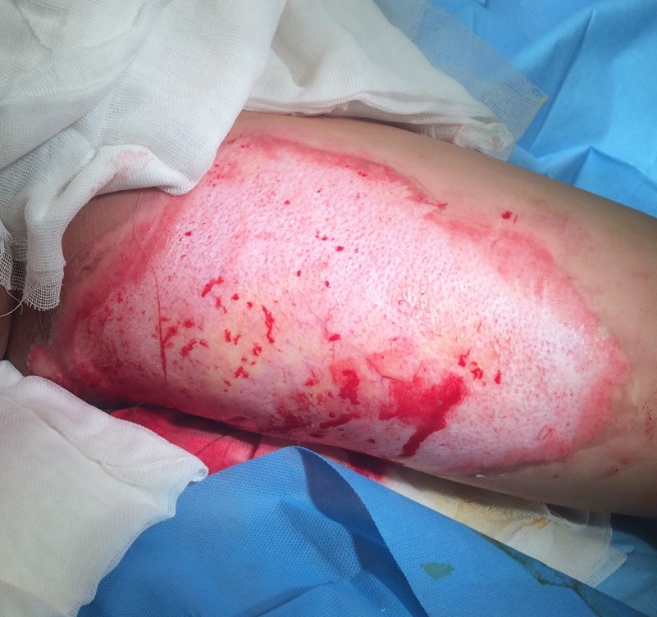
https://dr.ahmadabadi.ir

Slide 30
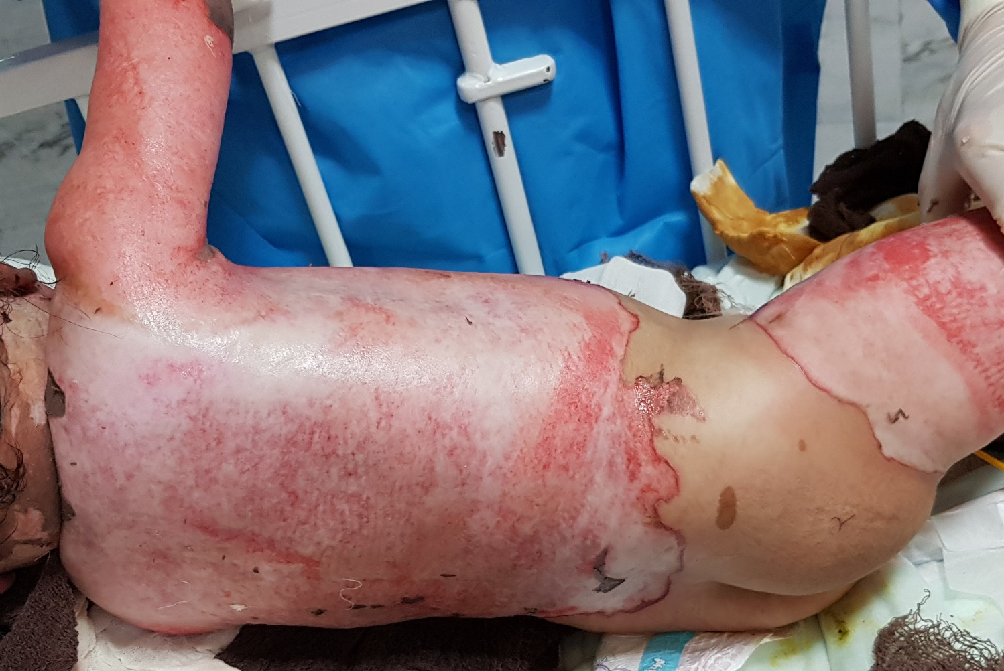
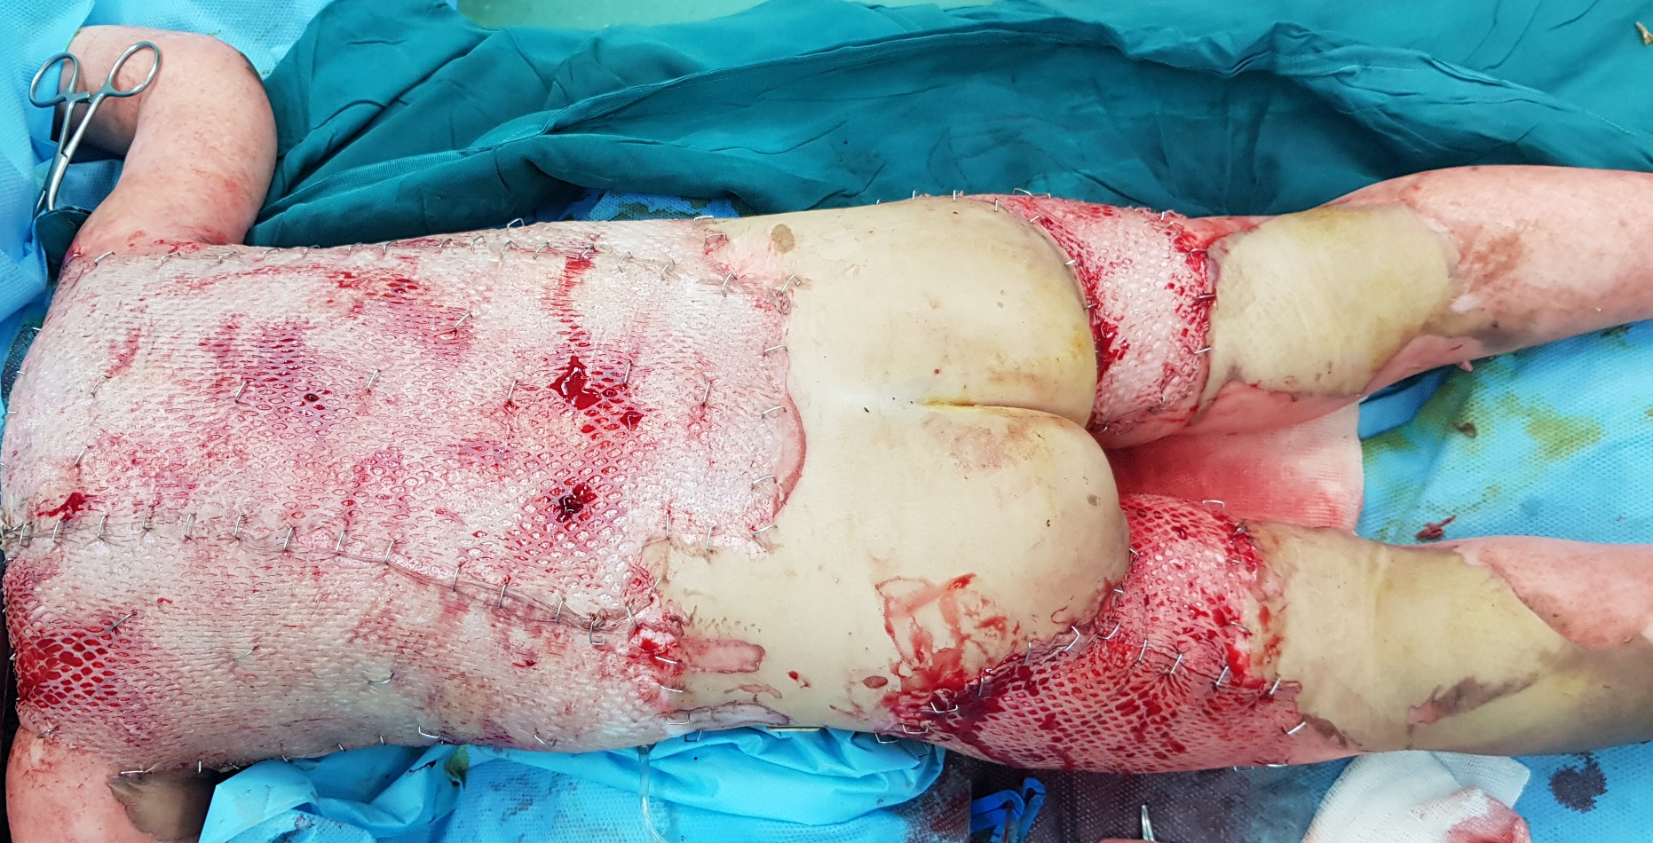
https://dr.ahmadabadi.ir

Slide 31
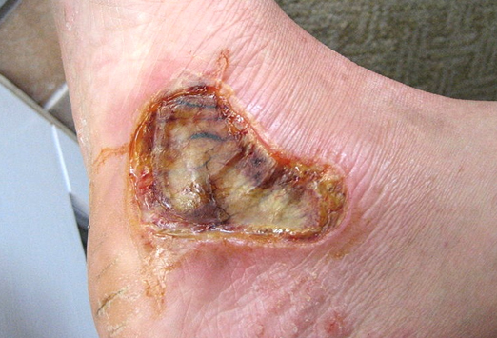
You are visiting a 40 years old man with the present burn injury after contacting with motorcycle exhaust pipe one from week ago.
What do you do?
https://dr.ahmadabadi.ir

Slide 32
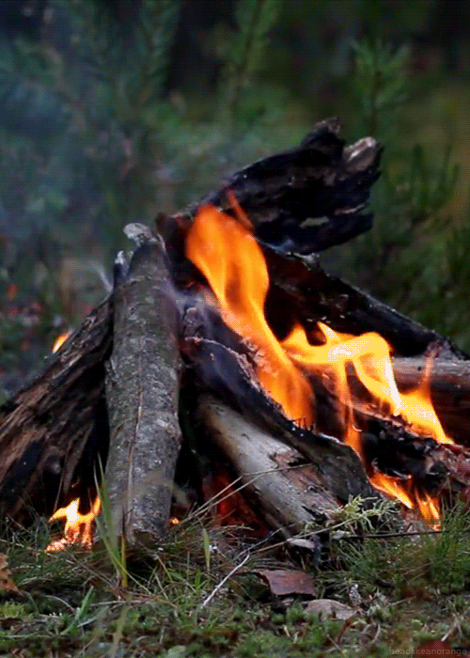
Thanks for your attention
https://dr.ahmadabadi.ir

