Slide 1
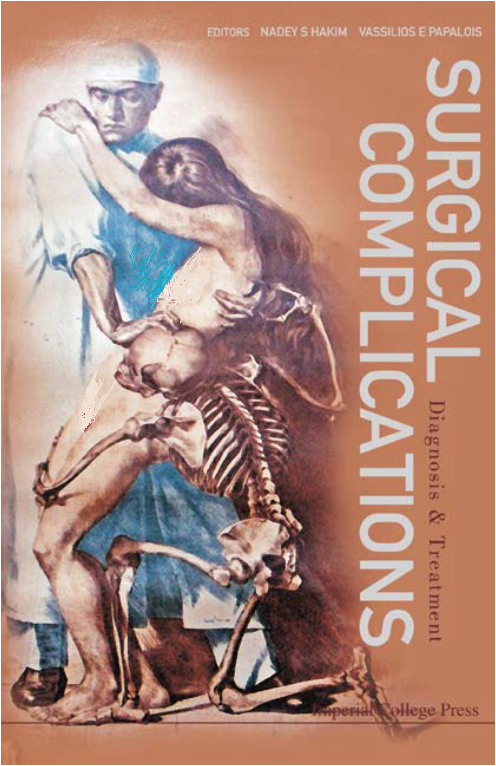
Common complications in surgery
Ali Ahmadabadi (MD)
Assistant Professor of surgery
Mashhad University of Medical Sciences

Slide 2
Krishen Sieunarine and J. Richard Smith surgical complications chapter 19
Unfortunately all of us who operate have patients with complications occurring because of the surgery.
The only surgeon without surgical complications is the “armchair” surgeon who does not do any surgery.

Slide 3
Professor Owen H. Wangensteen, one of the greatest academic surgeons of the 20th century
Nadey S. Hakim & Vassilios E. Papalois, Surgical complications. Preface,
You are a true surgeon from the moment you are able to deal with your complications.

Slide 4
6∑ theory
Medicine is considered a high-risk system with a high error rate.
one of the highest risk systems in existence today, the U.S. Navy’s nuclear submarine program, has an unmatched safety record.
High Reliability Organizations

Slide 5
Never events
Never events are errors in medical care that are clearly identifiable, preventable, and serious in their consequences for patients and that indicate a real problem in the safety of a healthcare facility.
retained surgical items,
wrong-site surgery, and
death on the day of surgery of a normal healthy patient

Slide 6
Types of medical error
1. Adverse event
  Injury caused by medical management rather than the underlying condition of the patient
  Prolongs hospitalization, produces a disability at discharge, or both
  Classified as preventable or unpreventable

Slide 7
Types of medical error
2. Negligence
  Care that falls below a recognized standard of care
  Standard of care is considered to be care a reasonable physician of similar knowledge, training, and experience would use in similar circumstances

Slide 8
Types of medical error
3. Near miss
  An error that does not result in patient harm.
  Analysis of near misses provides the opportunity to identify and remedy system failures before the occurrence of harm

Slide 9
Types of medical error
4. Sentinel event
An unexpected occurrence involving death or serious physical or psychological injury.
The injury involves loss of limb or function.
requires immediate investigation and response.
Hemolytic transfusion reaction due to administration of blood products having major blood group incompatibilities.
Wrong-site, wrong-procedure, or wrong-patient surgery.
A medication error or other treatment-related error resulting in death.
Unintentional retention of a foreign body in a patient after surgery.

Slide 10
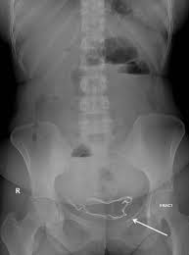
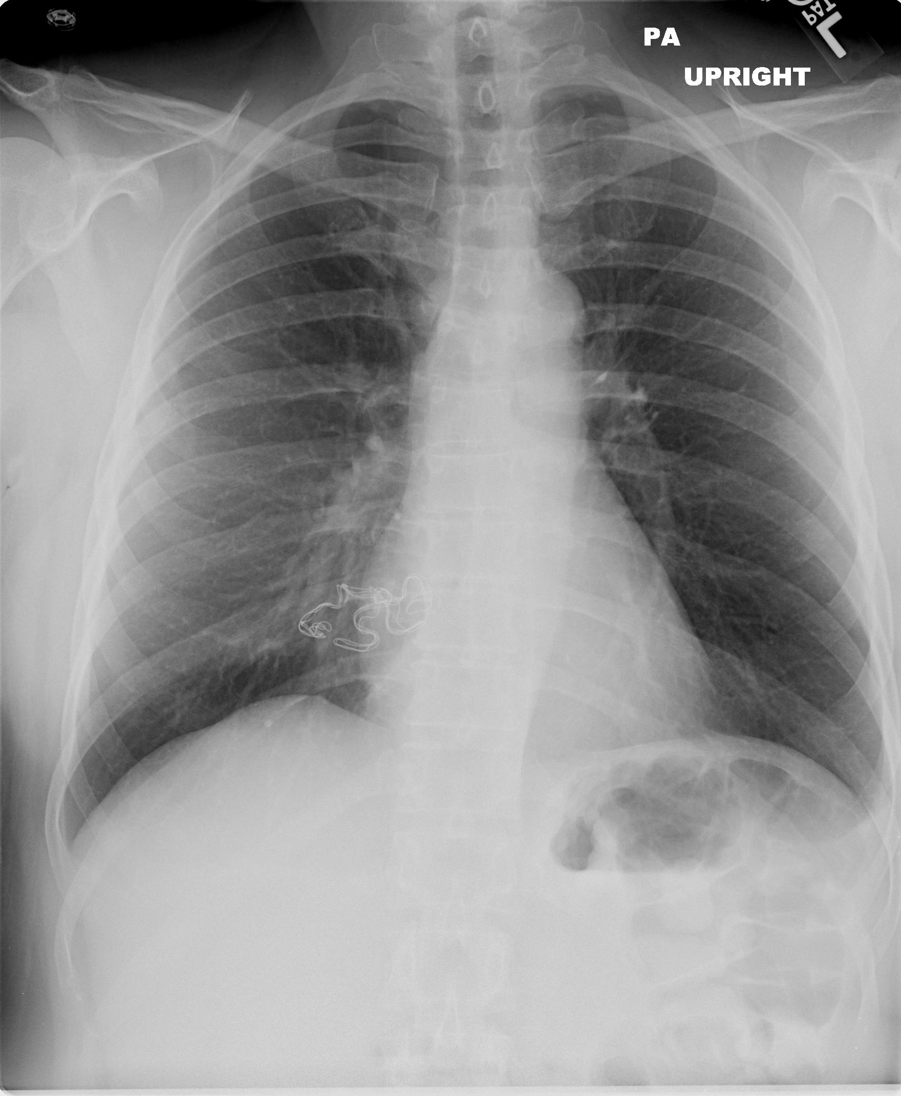
What’s ur diagnosis?

Slide 11
Retained Surgical Items
One case per 8000 to 18,000 operations.
One case or more each year for a typical large hospital or approximately 1500 cases per year in the United States.
The most common retained surgical item is a surgical sponge,
surgical instruments and
needles.

Slide 12
Risk factors for retained surgical sponges
Emergency surgery
Unplanned changes in procedure
Patient with higher body mass index
Multiple surgeons involved in same operation
Multiple procedures performed on same patient
Involvement of multiple operating room nurses/staff members
Case duration covers multiple nursing “shifts”

Slide 13
Complications in Minor Procedures
Central Venous Access Catheters
use of ultrasound for placement of all central venous lines.
subclavian catheters have been alternatively placed at the internal jugular position.
Pneumothorax: both subclavian and internal jugular vein: 1% to 6%.
If the patient is stable, and the pneumothorax is small (<15%), close expectant observation.
Arrhythmias
Arterial Puncture
Lost Guidewire

Slide 14
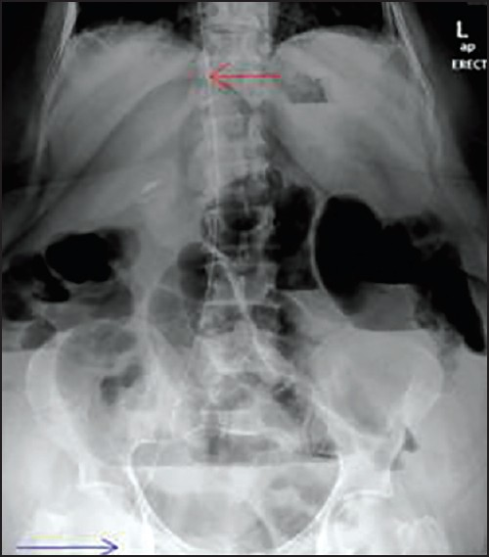
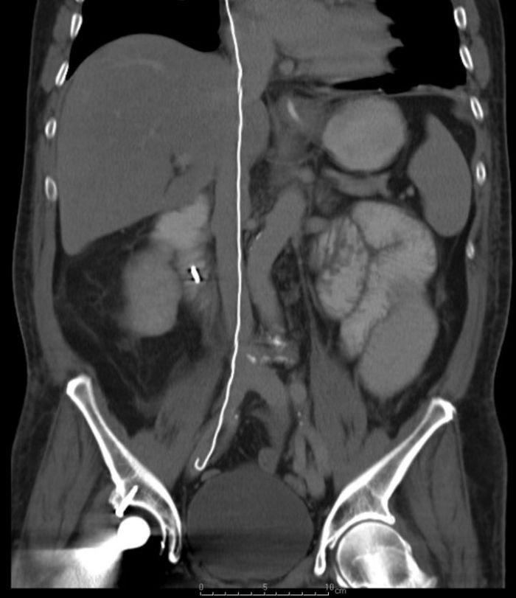
Plain abdominal radiograph. The retained guide wire is seen from the inferior vena cava (red arrow) up to the right femoral vein (blue arrow)

Slide 15
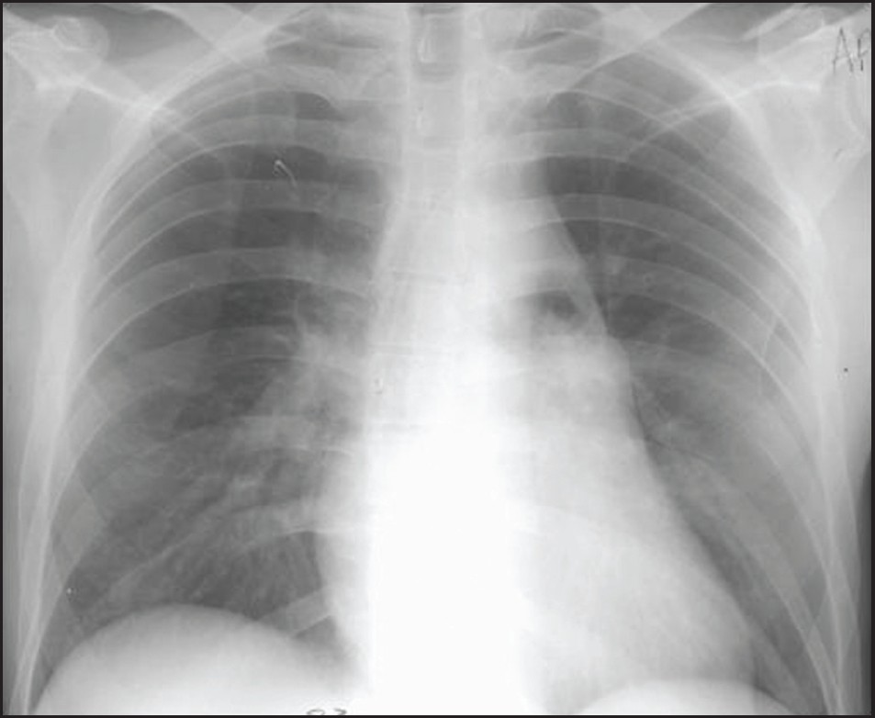

Slide 16
Complications in Minor Procedures
Central Venous Access Catheters
Air Embolus: 0.2% to 1% of patients.
Immediate left lateral decubitus Trendelenburg position, so the entrapped air can be stabilized within the right ventricle.
Auscultation over the precordium may reveal a “crunching” noise, portable CXR will help confirm the diagnosis. Aspiration via a central venous line accessing the heart may decrease the volume of gas in the right side of the heart and minimize the amount traversing into the pulmonary circulation
Treatment may prove futile if the air bolus >50 mL.

Slide 17
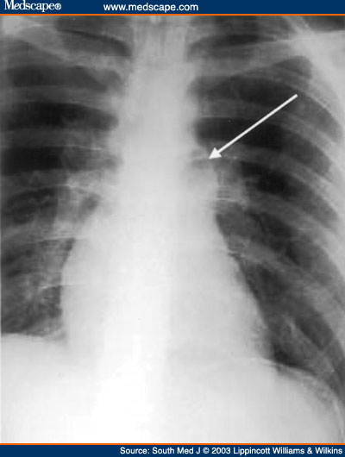
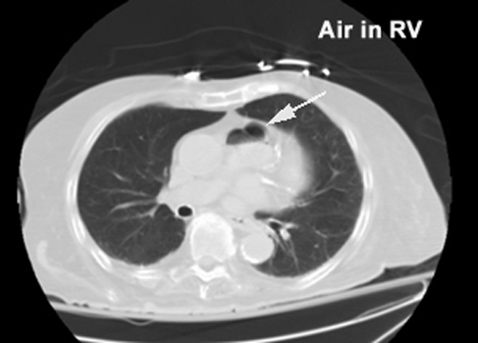
Large air embolism due to left subclavian central line placement with air evident in the main pulmonary artery

Slide 18
Complications in Minor Procedures
Central Venous Access Catheters
Pulmonary Artery Rupture: pulmonary artery (“Swan-Ganz”) catheters.
A sentinel bleed with coughing when a pulmonary artery catheter balloon is inflated, followed by uncontrolled hemoptysis.
Reinflation of the catheter balloon is the initial step in management, followed by immediate airway intubation with mechanical ventilation, an urgent portable CXR, and notification of the OR that an emergent thoracotomy may be required.
conservative nonoperative approach.
Pulmonary angiogram with angioembolization or vascular stenting
Hemodynamically unstable patients: thoracotomy.

Slide 19
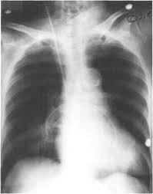
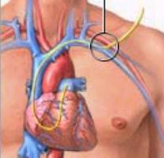

Slide 20
Complications in Minor Procedures
Central Venous Access Catheters
Central Venous Line Infection: mortality rate 12% to 25% when a central venous line infection becomes systemic.
In many instances, once an infection is recognized as central line sepsis, removing the line is adequate. Staphylococcus aureus infections, however, present a unique problem because of the potential for metastatic seeding of bacterial emboli. The required treatment is 4 to 6 weeks of tailored antibiotic therapy.

Slide 21
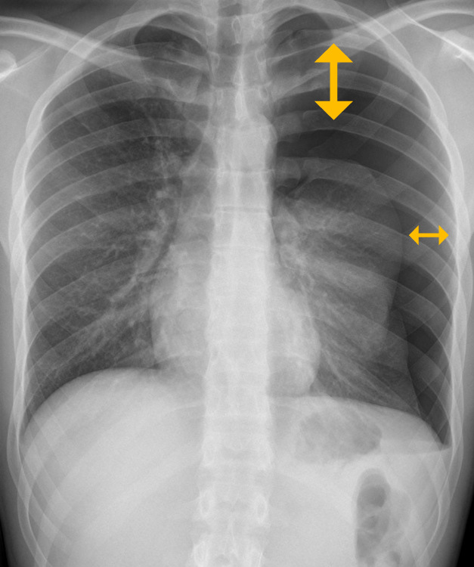

Slide 22
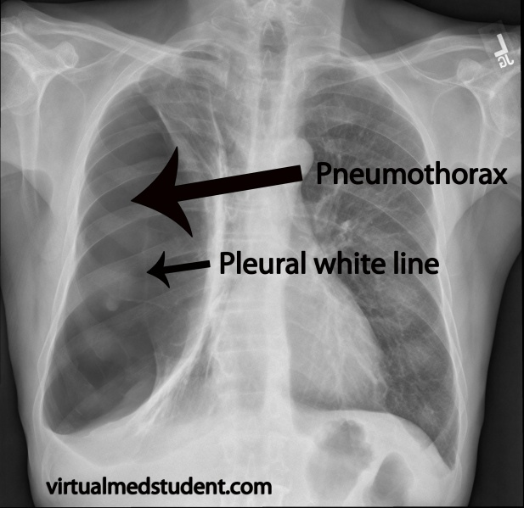

Slide 23
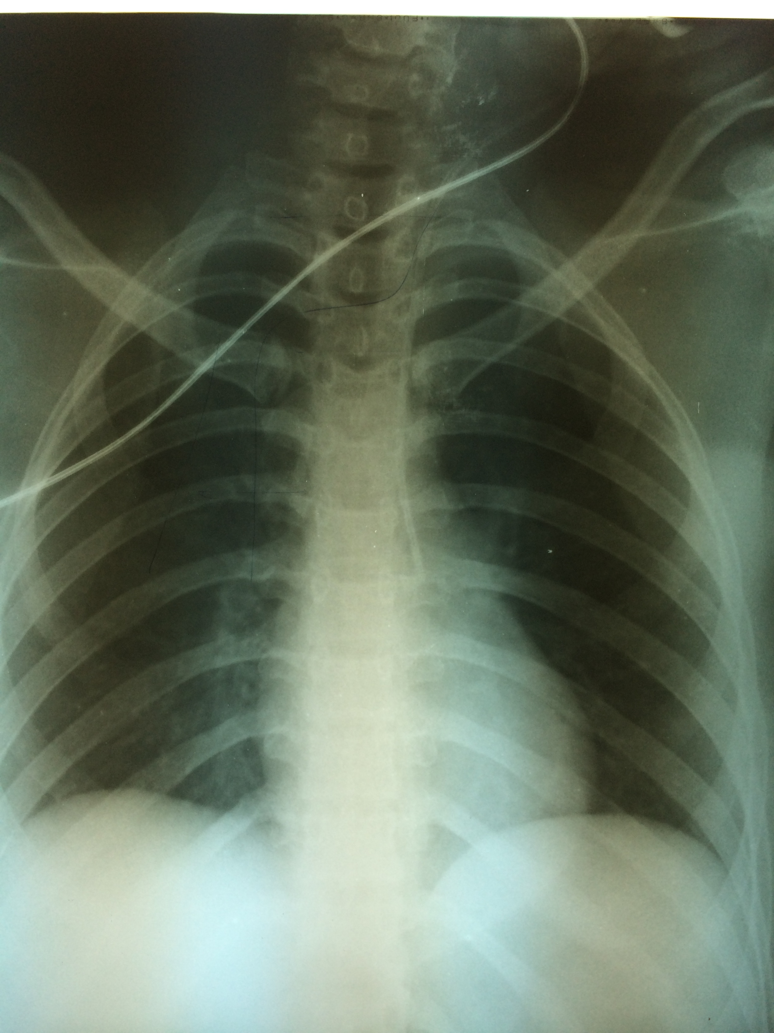

Slide 24
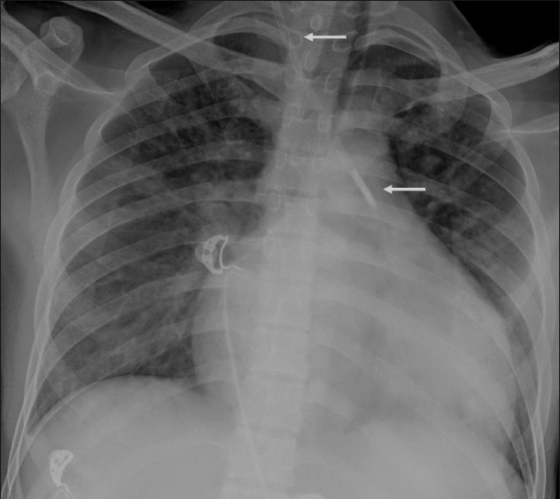

Slide 25

Complications in Minor Procedures
Arterial Lines
Arterial access requires a sterile Seldinger technique, and a variety of arteries are used: radial, femoral, brachial, axillary, dorsalis pedis, or superficial temporal arteries. Although complications occur less than 1% of the time, they can be catastrophic. Complications include thrombosis, bleeding, hematoma, arterial spasm (nonthrombotic pulselessness), and infection. Thrombosis or embolization of an extremity arterial catheter can result in the loss of a digit, hand, or foot.
Thrombosis with distal tissue ischemia is treated with anticoagulation, but occasionally surgical intervention is required. Pseudoaneurysms and arteriovenous fistulae can also occur.

Slide 26
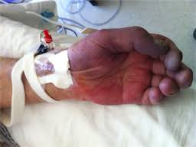
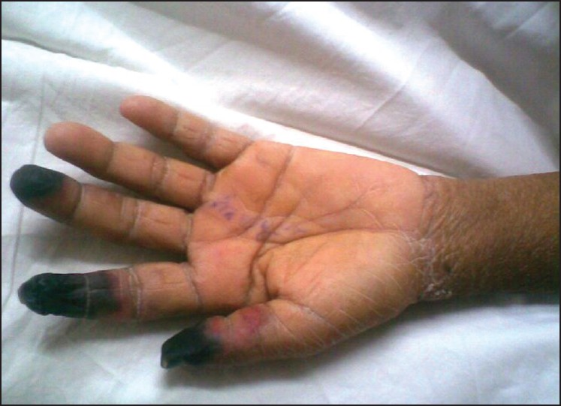
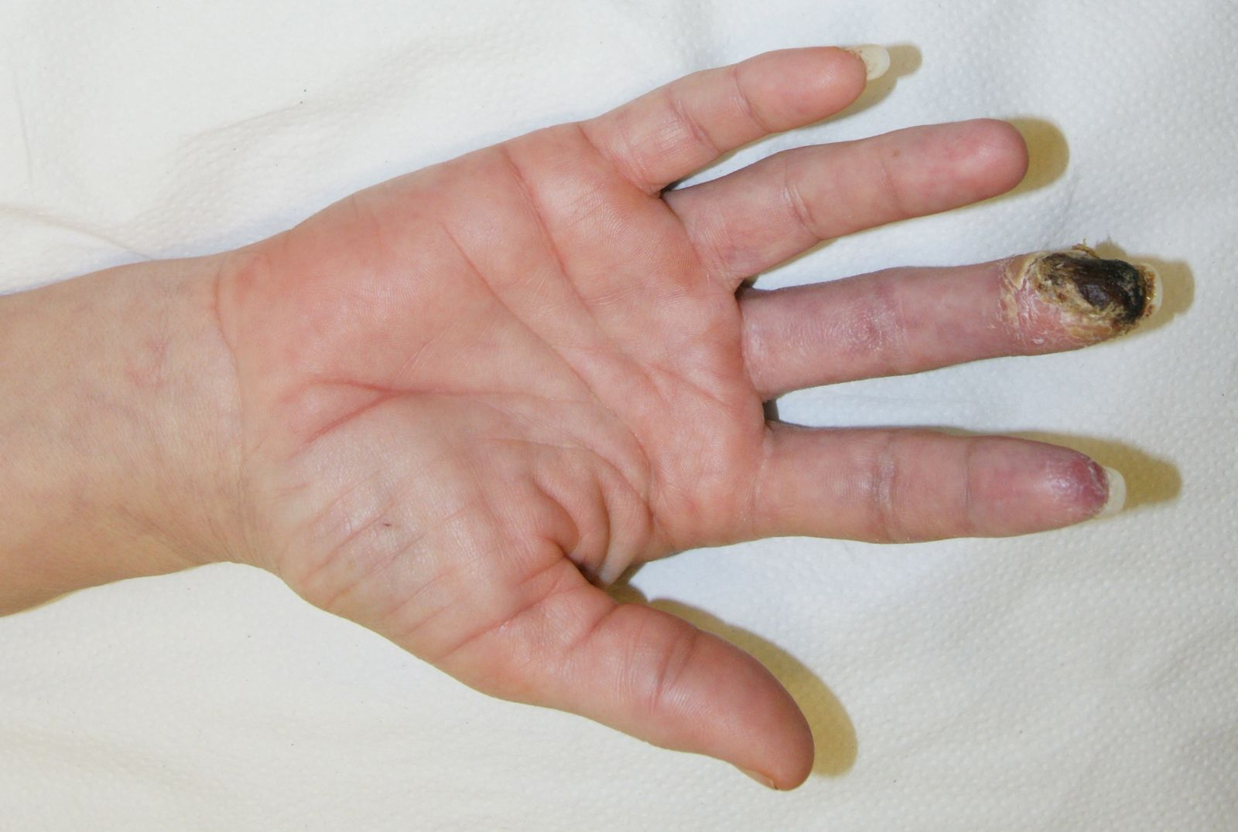

Slide 27
Endoscopy and Bronchoscopy.
Gastrointestinal (GI) endoscopy: Perforations: without biopsy: 1:10,000 with biopsy: up to 10%.
Nonoperative management: elective, bowel-prepped endoscopy, without significant pain or clinical signs of infection.
These patients must monitored, on strict dietary restriction and broad-spectrum antibiotics.
Complications of bronchoscopy include bronchial plugging, hypoxemia, pneumothorax, lobar collapse, and bleeding.
Bleeding: resolves spontaneously and rarely requires surgery, but may require repeat endoscopy for coagulation or fibrin glue application.
Pneumothorax
Lobar collapse or mucous plugging
If biopsies have been performed, the risk for these complications increases.

Slide 28
Tracheostomy
The most dramatic complication of tracheostomy is tracheoinnominate artery fistula (TIAF). occurs rarely (~0.3%) but 50% to 80% mortality.
TIAFs 2 days to 2 months after tracheostomy.
A sentinel bleed in 50% of TIAF cases, followed by a large-volume bleed.
the patient should be transported immediately to the OR for fiberoptic evaluation. If needed, remove the tracheostomy and place a finger through the tracheostomy site to apply direct pressure anteriorly for compression of the innominate artery while preparation for a more definitive approach is organized.

Slide 29
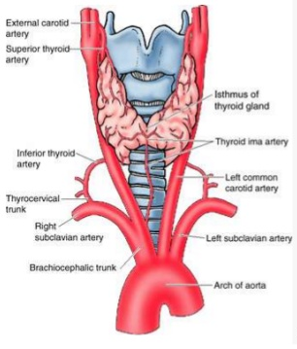
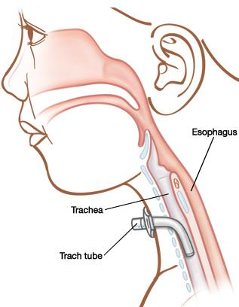
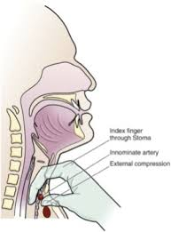
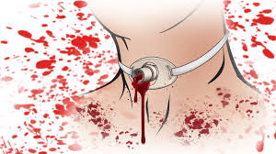

Slide 30
Percutaneous Endogastrostomy (PEG)
A misplaced percutaneous endogastrostomy (PEG) tube may lead to intra-abdominal sepsis with peritonitis and/or an abdominal wall abscess with necrotizing fasciitis.
Inadvertent colotomies, intraperitoneal placement of the tube and subsequent leakage of tube feeds with peritonitis, and abdominal wall abscesses require surgery to correct the complications and to replace the PEG with an alternate feeding tube, usually a jejunostomy.
A dislodged or prematurely removed PEG tube should be replaced as early as possible. A contrast x-ray (sinogram) should be performed to confirm the tube’s intra gastric position before feeding.
If there is uncertainty of the tube location, conversion to an open tube placement procedure is required.

Slide 31
Tube Thoracostomy
subcutaneous track, lacerations to the lung or diaphragm, intraperitoneal placement of the tube through the diaphragm, and bleeding related to these various lacerations or injury to pleural adhesions
residual pneumothorax.
The anterior chest wall is up to 1 cm thicker than the lateral chest wall, so needle decompression is more effective in the lateral position. Attempted prehospital needle decompression in the traditional anterior position results in only 50% needle entry into the thoracic cavity.

Slide 32
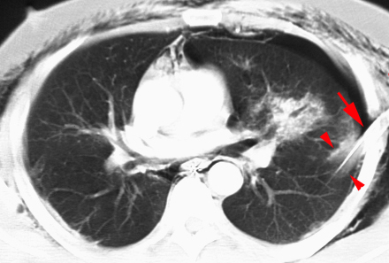
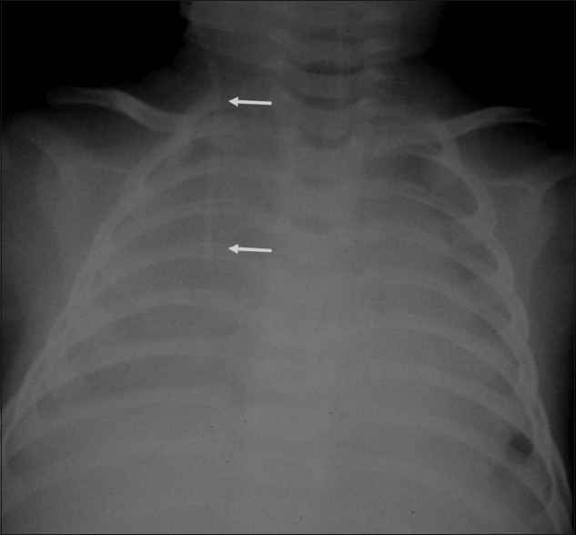
CT demonstrating chest tube (arrow) penetrating lung parenchyma with surrounding intra parenchymal hematoma (arrow heads).
chest radiograph of a patient who was receiving fluids through a right jugular central venous catheter (arrows) shows an opaque right hemithorax (which was a fresh finding compared to earlier normal radiographs). This was due to vessel perforation by the catheter and resultant accumulation of fluid in the pleural space

Slide 33
Complications of Angiography
Intramural dissection of a cannulated artery can lead to complications such as ischemic stroke from a carotid artery dissection or occlusion, mesenteric ischemia from dissection of the superior mesenteric artery, or a more innocuous finding of “blue toe syndrome” from a dissected artery in a peripheral limb.
Bleeding into the retroperitoneal tissue planes after femoral artery cannulation. Urgent surgical exploration may be required to control the bleeding site and evacuate larger hematomas.
Renal complications of angiography occur in 1% to 2% of patients: Contrast nephropathy.

Slide 34
Complications of Biopsies.
Lymph node biopsies: bleeding, infection, lymph leakage, and seromas.
Measures to prevent direct complications: proper surgical hemostasis, proper skin preparation, and a single preoperative dose of antibiotic to cover skin flora 30 to 60 minutes before incision.
Bleeding at a biopsy site:direct pressure.
Infection at a biopsy site: 5 to 10 days postoperatively may require opening of the wound to drain the infection.
Seromas or lymphatic leaks: aspiration, application of pressure dressings, or even placement of a vacuum drain.

Slide 35
Organ System Complications
Neurologic System
neurapraxia secondary to improper positioning and/or padding during operations
Direct injury to nerves:superficial parotidectomy (facial nerve), carotid endarterectomy (hypoglossal nerve), thyroidectomy (recurrent laryngeal nerve), prostatectomy (nervi erigentes), inguinal herniorrhaphy (ilioinguinal nerve), and mastectomy (long thoracic and thoracodorsal nerves).
Mental status changes: numerous causes. Postoperatively, hypotension and hypoxemia are the most likely causes of a cerebrovascular accident.

Slide 36
Organ System Complications
Eyes, Ears, and Nose
Corneal abrasions.
Overlooked contact lenses → conjunctivitis.
Persistent epistaxis after NG tube placement or removal: direct pressure on the external nares, Anterior and posterior nasal gauze packing with balloon tamponade, angioembolization, and fibrin glue. The use of antibiotics for posterior packing is controversial.
External otitis and otitis media postoperatively: topical antibiotics and nasal decongestion.
Ototoxicity due to aminoglycoside administration occurs in up to 10% of patients, and is often irreversible.
Vancomycin related ototoxicity occurs about 3% of the time when used alone, and as often as 6% when used with other ototoxic agents.

Slide 37
Organ System Complications
Vascular Problems of the Neck
Carotid endarterectomy: central or regional neurologic deficits and bleeding with an expanding neck hematoma.
An acute change in mental status or the presence of localized neurologic deficit: immediate return to the OR.
An expanding hematoma: emergent airway intubation and transfer to OR
Other complications include arteriovenous fistulae, pseudoaneurysms, and infection, all of which are treated surgically.
Intraoperative hypotension during manipulation of the carotid bifurcation: increased tone from baroreceptors and reflexly bradycardia: injection of 1% lidocaine solution around this structure.
The most common delayed complication following carotid endarterectomy: MI.

Slide 38
Organ System Complications
Thyroid and Parathyroid Glands
Hypocalcemia: calcium gluconate infusion and, if tetany ensues, chemical paralysis with intubation.
Maintenance treatment is thyroid hormone replacement (after thyroidectomy) in addition to calcium carbonate and vitamin D.
Recurrent laryngeal nerve (RLN) injury: < 5%. approximately 10% are permanent.
At the conclusion of the operation, if there is suspicion of an RLN injury, direct laryngoscopy is diagnostic. The cord on the affected side will be in the paramedian position. With bilateral RLN injury, the chance of a successful extubation is poor.
Superior laryngeal nerve injury: loss of projection of the voice. Management is limited to clinical observation.

Slide 39
Organ System Complications
Respiratory System
Pulmonary atelectasis: can predispose to pneumonia: prevention: sitting the patient as much as possible, early ambulation, and adequate pain control. An increase in FRC by 700 mL or more can be accomplished by sitting patients up to greater than 45°. For mechanically ventilated patients, simply placing the head of the bed at 30 to 45° elevation and delivering adequate tidal volumes (8–10 mL/kg).
bronchial plugging and lobar collapse: inadequate pulmonary toilet, copious and tenacious secretions: diagnosis: CXR and clinical suspicion with acute pulmonary decompensation with increased work of breathing and hypoxemia. Fiberoptic bronchoscopy to clear mucous plugs and secretions.
Aspiration complications include pneumonitis and pneumonia.
The treatment of pneumonitis is similar to ARDS: oxygenation with general supportive care. Antibiotics are not indicated.
Hospitalized patients who develop aspiration pneumonitis: mortality rate 70% to 80%. Early, aggressive, and repeated bronchoscopy for suctioning of aspirated material

Slide 40

Organ System Complications
Respiratory System
Pneumonia: second most common nosocomial infection and the most common infection in ventilated patients.
VAP occurs in 15% to 40% of ventilated ICU patients, with a probability rate of 5% per day, up to 70% at 30 days. The 30-day mortality rate of nosocomial pneumonia can be as high as 40% and depends on the microorganisms involved and the timeliness of initiating appropriate antimicrobials
Begin treatment with broad-spectrum antibiotics . The spectrum of antibiotic coverage should be narrowed as soon as the culture sensitivities are determined.
Double-coverage antibiotic strategy for the two pathogens, Pseudomonas and Acinetobacter spp.
One of the most helpful tools in treating pneumonia and other infections is the tracking of a medical center’s antibiogram every 6 to 12 months.

Slide 41

Organ System Complications
Respiratory System
Inclusion criteria for ARDS
    Acute onset
    Predisposing condition
    Pao2:Fio2 <200 (regardless of positive end-expiratory pressure)
    Bilateral infiltrates
    Pulmonary artery occlusion pressure <18 mmHg
    No clinical evidence of right heart failure
ARDS: partial pressure of oxygen in arterial blood (Pao2)/fraction of inspired oxygen (Fio2) ratios: mild (300–201 mmHg), moderate (200–101 mmHg), and severe (<100 mmHg).
Management; tidal volumes of only 5 to 7 mL/kg, PEEP,
As gas exchange improves with resolving ARDS, the initial step in decreasing ventilatory support should be to decrease the levels of supplemental oxygen first, and then to slowly bring the PEEP levels back down to minimal levels.

Slide 42
Organ System Complications
Cardiac System
Arrhythmias: AF is the most common arrhythmia occurs postoperative days 3 to 5 in high-risk patients, when interstitial fluid mobilize into the vascular fluid space.
The first-line treatment: β-blockade and/or calcium channel blockade.
β-Blockade: risk of hypotension and withdrawal rebound hypertension.
Calcium channel blockers: if β-blockers are not tolerated. Caution in those with a history of CHF.
Digoxin: limitations due to the need for optimal dosing levels.
Cardioversion may be required if patients become hemodynamically unstable and the rhythm cannot be controlled.
Ventricular arrhythmias: best controlled with β-blockade, other antiarrhythmics or cardioversion if patients become hemodynamically unstable.

Slide 43
Organ System Complications
Cardiac System
Acute myocardial infarction (AMI) can present insidiously, or it can be more dramatic with the classic presentation of shortness of breath, severe angina, and sudden cardiogenic shock.
Workup: ECG and cardiac enzyme.
The patient should be transferred to a monitored (telemetry) floor.
Morphine, supplemental oxygen, nitroglycerine, and aspirin (MONA) are the initial therapeutic maneuvers for those being investigated for AMI.

Slide 44
Organ System Complications
Gastrointestinal System
Postoperative ileus: restrict narcotic use, Epidural anesthesia, limited use of NG tubes, early postoperative feeding, chewing gum?
Pharmacologic agents: Metoclopramide is limited to the stomach and duodenum,→ gastroparesis.
Erythromycin: motilin agonist, works throughout the stomach and bowel.
Alvimopan: mu-opioid receptor antagonist, has shown some promise.
Neostigmine: in refractory pan-ileus patients (Ogilvie’s syndrome) therapy to be in a monitored unit.
Small bowel obstruction: <1% of early postoperative patients. adhesions are usually the cause. Internal and external hernias, technical errors, and infections or abscesses are also causative.
Hyaluronidase: a mucolytic enzyme that degrades connective tissue, and the use of a methylcellulose form of hyaluronidase, Seprafilm, has been shown to result in a 50% decrease in adhesion formation in some patients.

Slide 45
Organ System Complications
Gastrointestinal System
Fistula: Common causes for fistula formation are summarized in the mnemonic FRIENDS (Foreign body, Radiation, Ischemia/Inflammation/Infection, Epithelialization of a tract, Neoplasia, Distal obstruction, and Steroid use).
GI bleeding: Technical errors, The source of bleeding is in the upper GI (85% of the time and is usually detected and treated endoscopically.
Proton pump inhibitors, H2-receptor antagonists, and intragastric antacid installation are all effective measures.
patients who are not mechanically ventilated or who do not have a history of gastritis or peptic ulcer disease should not be placed on gastritis prophylaxis postoperatively because it carries a higher risk of causing pneumonia.

Slide 46
Hepatobiliary-Pancreatic System
are usually due to technical errors.
common bile duct injury: Laparoscopic > Open cholecystectomy
Ischemic injury due to devascularization of CBD: presentation days to weeks after an operation. ERCP demonstrates a stenotic, smooth common bile duct, and LFTs are elevated. The recommended treatment is a Roux-en-Y hepaticojejunostomy.
bile leak → Biloma. → abdominal pain and hyperbilirubinemia.
Diagnosis: CT scan, ERCP, or radionuclide scan.
Treatment: retrograde biliary stent and external drainage are the treatment of choice.
Pancreatitis after ERCP.

Slide 47
Renal System
Renal failure: Pre renal, Renal, Post renal.
Oliguria: first flushing the urinary catheter using sterile technique.
Urine electrolytes, hemoglobin and hematocrit should be measured. Patients in compensated shock from acute blood loss may manifest anemia and end-organ malperfusion as oliguria.

Slide 48
Musculoskeletal System
compartment syndrome: hallmark: pain with passive motion.
anterior compartment of the leg is usually the first compartment to be involved.
Diagnosis: direct pressure measurement > 20 to 25 mmHg in any of the compartments, then a four-compartment fasciotomy is considered.
Compartment syndrome can be due to ischemia-reperfusion injury, after an ischemic time of 4 to 6 hours.
Renal failure (due to myoglobinuria), tissue loss, and a permanent loss of function are possible results of untreated compartment syndrome.

Slide 49
Hematologic System
Rate of viral transmission in blood product transfusions
  HIV 1:1.9 million
  HBV 1:137,000
  HCV 1:1 million
Patients on warfarin (Coumadin) who require surgery: anticoagulation reversal by FFP.
Each unit of FFP contains 200 to 250 mL of plasma and includes one unit of coagulation factor / ml of plasma.
Thrombocytopenia: transfusion for platelet count less than 20,000/mL, when invasive procedures are performed, or when platelet counts are low and ongoing bleeding from raw surface areas persists.
One unit of platelets will increase the platelet count by 5000 to 7500 per mL in adults.
RBC: Hct<21 or Hb< 7. Unless in patients who suffer from significant cardiac disease, or who are critically ill and require higher levels of Hb to increase oxygen carrying capacity

Slide 50
Abdominal Compartment Syndrome(ACS)
causative factors: Multisystem trauma, thermal burns, retroperitoneal injuries and surgery, Ruptured AAA, major pancreatic injury and resection, or multiple intestinal injuries.
Manifestations: progressive abdominal distention, increased peak airway ventilator pressures, oliguria followed by anuria, and an insidious development of intracranial hypertension.
Measurement of abdominal pressures: bladder pressures from the urinary catheter after instilling 100 mL of sterile saline into the urinary bladder. A pressure greater than 20 mmHg constitutes intraabdominal hypertension, but the diagnosis of ACS requires intra-abdominal pressure greater than 25 to 30 mmHg, with at least one of the following: compromised respiratory mechanics and ventilation, oliguria or anuria, or increasing intracranial pressures.
The treatment of ACS is to open any recent abdominal incision to release the abdominal fascia or to open the fascia directly if no abdominal incision is present. Immediate improvement in mechanical ventilation pressures, intracranial pressures, and urine output is usually noted.

Slide 51
Urinary Catheters
The most frequent nosocomial infection is UTI.
classified into complicated and uncomplicated. The uncomplicated type is a UTI that can be treated with outpatient antibiotic therapy. The complicated UTI usually involves a hospitalized patient with an indwelling catheter whose UTI is diagnosed as part of a fever workup.
The interpretation of urine culture results <100,000 CFU/mL is controversial. Before treating such a patient, one should change the catheter and then repeat the culture to see if the catheter was simply colonized with organisms.
Cultures> 100,000 CFU/mL should be treated with the appropriate antibiotics and the catheter changed or removed as soon as possible.
Candida albicans fungal bladder infections: Continuous bladder washings with fungicidal solution for 72 hours have been recommended. Replacement of the urinary catheter and a course of fluconazole are appropriate treatments.
C. albicans in the urine may serve as an indication of fungal infection elsewhere in the body. If this is the case, then screening cultures for other sources of fungal infection should be performed whenever a fungal UTI is found.

Slide 52
Necrotizing Fasciitis
Postoperative infections that progress to the fulminant soft tissue infection.
Group A streptococcal pyogenes, Clostridium perfringens and C. septicum, carry a mortality of 30% to 70%. Septic shock can be present, and patients can become hypotensive less than 6 hours following inoculation.
Manifestations of a group A Streptococcus pyogenes infection in its most severe form include hypotension, renal insufficiency, coagulopathy, hepatic insufficiency, ARDS, tissue necrosis, and erythematous rash.
Treatment: surgical emergency wide debridement of the necrotic tissue to the level of bleeding, viable tissue. A gray serous fluid at the level of the necrotic tissue is usually noted, and as the infection spreads, thrombosed blood vessels are noted along the tissue planes involved with the infection.
serial trips to the OR.
Broad-spectrumantibiotics are an important adjunct to surgical debridement because these infections may be polymicrobial (mixed-synergistic infections).
S. pyogenes is eradicated with penicillin, and it should still be used as the initial drug of choice.

Slide 53
Problems with Thermoregulation
Hypothermia
core temperature less than 35°C (95°F)
Mild (35–32°C, moderate (32–28°C, and severe (<28°C.
Shivering, occurs between 37 and 31°C, but ceases at temperatures below 31°C.
Patients who are moderately hypothermic are at higher risk for complications than are those who are more profoundly hypothermic.
Hypothermia creates a coagulopathy that is related to platelet and clotting cascade enzyme dysfunction. This triad of metabolic acidosis, coagulopathy, and hypothermia is commonly found in long operative cases and in patients with blood dyscrasias. (Lethal triad)

Slide 54
The most common cardiac abnormality is the development of arrhythmias when body temperature drops below 35°C (95°F). Bradycardia occurs with temperatures below 30°C (86°F).
Hypothermia may induce CO2 retention, resulting in respiratory acidosis.
Renal dysfunction of hypothermia manifests itself as a paradoxic polyuria. The brisk urine output provides a false sense of an adequate intravascular fluid volume.
A rate of temperature rise of 2 to 4°C/h is considered adequate, but the most common complication for rewarming is arrhythmia with ventricular arrest.
Induced peripheral hypothermia for hyperpyrexia due to infection (not to include neurologic or cardiac disease) is likely deleterious and does not appear to be beneficial.
A subsequent feedback loop triggers the hypothalamus to raise the internally regulated set point, thus raising core temperature even higher.
Poor data exist in support of treating fevers lower than 42°C in any fashion.

Slide 55
Problems with Thermoregulation
Hyperthermia core temperature greater than 38.6°C.

Slide 56
Malignant hyperthermia
occurs after exposure to agents such as succinylcholine and some halothane-based inhalational anesthetics.
The presentation is dramatic, with rapid onset of increased temperature, rigors, and myoglobinuria related to myonecrosis.
Medications must be discontinued immediately and dantrolene administered (2.5 mg/kg every 5 minutes) until symptoms subside.
Aggressive cooling methods are also implemented, such as an alcohol bath, or packing in ice.
In cases of severe malignant hyperthermia, the mortality rate is nearly 30%.

Slide 57
Thyrotoxicosis
Can occur after surgery due to undiagnosed Graves’ disease.
Hyperthermia (>40°C [104°F]), anxiety, copious diaphoresis, congestive heart failure (present in about one fourth of episodes), tachycardia (most commonly atrial fibrillation), and hypokalemia (up to 50% of patients) are hallmarks of the disease.
Treatment: glucocorticoids, propylthiouracil, β-blockade, and iodide (Lugol’s solution) delivered in an emergent fashion.
As the name suggests, these patients are usually toxic and require supportive measures as well. Acetaminophen, the cooling modalities, and vasoactive agents often are indicated.

